Slide 1

Lecture 4: A Brief Tour of Some Common Models of Nucleotide Substitution
Bastien Boussau & Brian Moore Laboratoire de Biométrie et Biologie Évolutive Université de Lyon
CoME, 2019

Slide 2
Statistical Estimation of Phylogeny: An Outline
Inference Method
Data
Model
Parameter
Estimates
sequence
alignment
tree with
branch lengths
maximum likelihood
phylogeny & other model parameters
substitution
model
Bayesian inference

Slide 3
Outline
I. A brief review of Continuous-Time Markov models

Slide 4
Outline
I. A brief review of Continuous-Time Markov models
II. Stochastic models of nucleotide substitution
What’s the deal with time reversibility
Meet the GTR family

Slide 5
Outline
I. A brief review of Continuous-Time Markov models
II. Stochastic models of nucleotide substitution
What’s the deal with time reversibility
Meet the GTR family
III. Accommodating among-site heterogeneity in the substitution process
Among-site variation in substitution rates
Among-site variation in substitution process

Slide 6
Outline
I. A brief review of Continuous-Time Markov models
II. Stochastic models of nucleotide substitution
What’s the deal with time reversibility
Meet the GTR family
III. Accommodating among-site heterogeneity in the substitution process
Among-site variation in substitution rates
Among-site variation in substitution process
IV. Accommodating heterogeneity in the substitution process along the tree

Slide 7
Stochastic Mechanisms of Character Change
Continuous-time Markov models
describe the stochastic process by which traits (nucleotides) evolve over the tree

Slide 8
Stochastic Mechanisms of Character Change
Continuous-time Markov models
describe the stochastic process by which traits (nucleotides) evolve over the tree
Instantaneous-rate matrix, Q
completely describes the stochastic process by specifying:

Slide 9
Stochastic Mechanisms of Character Change
Continuous-time Markov models
describe the stochastic process by which traits (nucleotides) evolve over the tree
Instantaneous-rate matrix, Q
completely describes the stochastic process by specifying:
Transition probabilities: pij(v), the probability of observing state j conditioned on starting in state i and running the process over a branch of length v
can be estimated by Monte Carlo simulation or matrix exponentiation, P(v) = e^{Qv}

Slide 10
Stochastic Mechanisms of Character Change
Continuous-time Markov models
describe the stochastic process by which traits (nucleotides) evolve over the tree
Instantaneous-rate matrix, Q
completely describes the stochastic process by specifying:
Transition probabilities: pij(v), the probability of observing state j conditioned on starting in state i and running the process over a branch of length v
can be estimated by Monte Carlo simulation or matrix exponentiation, P(v) = e^{Qv}
Stationary frequencies: the long-term probability of observing the chain in state j

Slide 11
Scaling the Instantaneous Rate Matrix
What is the scale of the instantaneous rates?
Substitution rate and time are confounded in most CTMC models

Slide 12
Scaling the Instantaneous Rate Matrix
What is the scale of the instantaneous rates?
Substitution rate and time are confounded in most CTMC models
The expected (mean) number of substitutions along a branch is a function of the duration of that branch, t, and the substitution rate, u

Slide 13
Scaling the Instantaneous Rate Matrix
What is the scale of the instantaneous rates?
Substitution rate and time are confounded in most CTMC models
The expected (mean) number of substitutions along a branch is a function of the duration of that branch, t, and the substitution rate, u
However, the timescale of the tree is typically unknown, so the time, t, and rate, u, cannot be estimated separately, but only as their product: v = ut

Slide 14
Scaling the Instantaneous Rate Matrix
What is the scale of the instantaneous rates?
Substitution rate and time are confounded in most CTMC models
The expected (mean) number of substitutions along a branch is a function of the duration of that branch, t, and the substitution rate, u
However, the timescale of the tree is typically unknown, so the time, t, and rate, u, cannot be estimated separately, but only as their product: v = ut
In order for us to be able to interpret the branch length, v, as the expected number of substitutions per site, the average substitution rate must be one

Slide 15
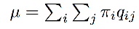
Scaling the Instantaneous Rate Matrix
What is the scale of the instantaneous rates?
Substitution rate and time are confounded in most CTMC models
The expected (mean) number of substitutions along a branch is a function of the duration of that branch, t, and the substitution rate, u
However, the timescale of the tree is typically unknown, so the time, t, and rate, u, cannot be estimated separately, but only as their product: v = ut
In order for us to be able to interpret the branch length, v, as the expected number of substitutions per site, the average substitution rate must be one
This is achieved by scaling the instantaneous-rate matrix by the weighted average of substitution rates:

Slide 16
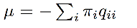
Scaling the Instantaneous Rate Matrix
What is the scale of the instantaneous rates?
Substitution rate and time are confounded in most CTMC models
The expected (mean) number of substitutions along a branch is a function of the duration of that branch, t, and the substitution rate, u
However, the timescale of the tree is typically unknown, so the time, t, and rate, u, cannot be estimated separately, but only as their product: v = ut
In order for us to be able to interpret the branch length, v, as the expected number of substitutions per site, the average substitution rate must be one
This is achieved by scaling the instantaneous-rate matrix by the weighted average of substitution rates:
or equivalently:

Slide 17
Scaling the Instantaneous Rate Matrix
What is the scale of the instantaneous rates?
Substitution rate and time are confounded in most CTMC models
The expected (mean) number of substitutions along a branch is a function of the duration of that branch, t, and the substitution rate, u
However, the timescale of the tree is typically unknown, so the time, t, and rate, u, cannot be estimated separately, but only as their product: v = ut
In order for us to be able to interpret the branch length, v, as the expected number of substitutions per site, the average substitution rate must be one
This is achieved by scaling the instantaneous-rate matrix by the weighted average of substitution rates:
weighted sum of off-diagonal rates
or equivalently:
negative weighted sum of diagonal rates

Slide 18
Scaling the Instantaneous Rate Matrix
What is the scale of the instantaneous rates?
Substitution rate and time are confounded in most CTMC models
The expected (mean) number of substitutions along a branch is a function of the duration of that branch, t, and the substitution rate, u
However, the timescale of the tree is typically unknown, so the time, t, and rate, u, cannot be estimated separately, but only as their product: v = ut
In order for us to be able to interpret the branch length, v, as the expected number of substitutions per site, the average substitution rate must be one
This is achieved by scaling the instantaneous-rate matrix by the weighted average of substitution rates:
or equivalently:
The rate of change from state i to state j is weighted by the probability of starting in state i, which is the stationary frequency of state i,

Slide 19
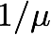
Scaling the Instantaneous Rate Matrix
What is the scale of the instantaneous rates?
Substitution rate and time are confounded in most CTMC models
The expected (mean) number of substitutions along a branch is a function of the duration of that branch, t, and the substitution rate, u
However, the timescale of the tree is typically unknown, so the time, t, and rate, u, cannot be estimated separately, but only as their product: v = ut
In order for us to be able to interpret the branch length, v, as the expected number of substitutions per site, the average substitution rate must be one
This is achieved by scaling the instantaneous-rate matrix by the weighted average of substitution rates:
or equivalently:
The rate of change from state i to state j is weighted by the probability of starting in state i, which is the stationary frequency of state i,
We then multiply each element in the instantaneous-rate matrix by the scalar

Slide 20
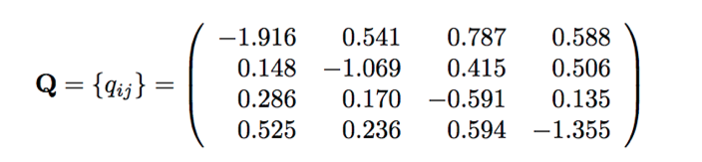
Scaling the Instantaneous Rate Matrix
Let’s check the scaling of our hypothetical rate matrix
The instantaneous-rate matrix...

Slide 21
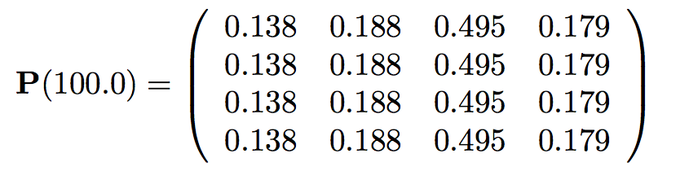
Scaling the Instantaneous Rate Matrix
Let’s check the scaling of our hypothetical rate matrix
The instantaneous-rate matrix...
Stationary frequencies...

Slide 22
Scaling the Instantaneous Rate Matrix
Let’s check the scaling of our hypothetical rate matrix
The instantaneous-rate matrix...
Stationary frequencies...
The (weighted) average substitution rate:

Slide 23
Scaling the Instantaneous Rate Matrix
Let’s check the scaling of our hypothetical rate matrix
The instantaneous-rate matrix...
Stationary frequencies...
The (weighted) average substitution rate:

Slide 24
Scaling the Instantaneous Rate Matrix
Let’s check the scaling of our hypothetical rate matrix
The instantaneous-rate matrix...
Stationary frequencies...
The (weighted) average substitution rate:
probability of starting in A

Slide 25
Scaling the Instantaneous Rate Matrix
Let’s check the scaling of our hypothetical rate matrix
The instantaneous-rate matrix...
Stationary frequencies...
The (weighted) average substitution rate:
probability of starting in A
overall rate of change away from A

Slide 26
Scaling the Instantaneous Rate Matrix
Let’s check the scaling of our hypothetical rate matrix
The instantaneous-rate matrix...
Stationary frequencies...
The (weighted) average substitution rate:
probability of starting in C
overall rate of change away from C

Slide 27
Scaling the Instantaneous Rate Matrix
Let’s check the scaling of our hypothetical rate matrix
The instantaneous-rate matrix...
Stationary frequencies...
The (weighted) average substitution rate:
probability of starting in G
overall rate of change away from G

Slide 28
Scaling the Instantaneous Rate Matrix
Let’s check the scaling of our hypothetical rate matrix
The instantaneous-rate matrix...
Stationary frequencies...
The (weighted) average substitution rate:
probability of starting in T
overall rate of change away from T

Slide 29
Scaling the Instantaneous Rate Matrix
Let’s check the scaling of our hypothetical rate matrix
The instantaneous-rate matrix...
Stationary frequencies...
The (weighted) average substitution rate:
The average substitution rate in our instantaneous-rate matrix is therefore 1!

Slide 30
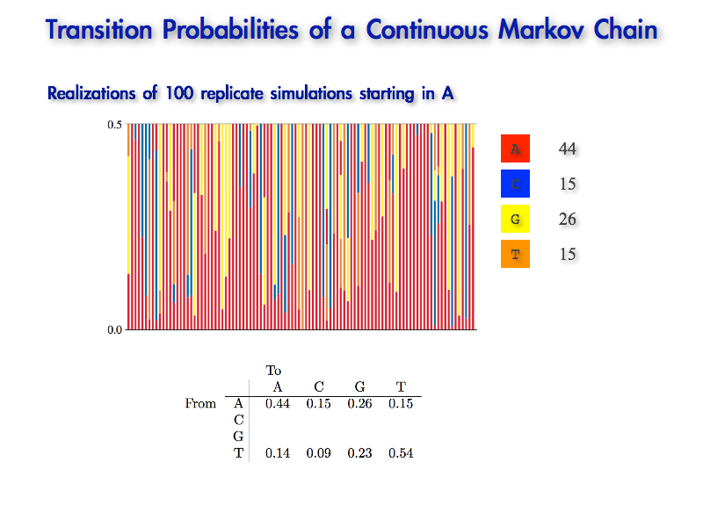
Scaling the Instantaneous Rate Matrix
Can we correctly estimate the true branch length used in our simulation?
The true branch length was
For simulations starting in A, the average number of changes was = 0.788

Slide 31
Scaling the Instantaneous Rate Matrix
Can we correctly estimate the true branch length used in our simulation?
The true branch length was
We compute the average number of changes for each starting state,
For simulations starting in A, the average number of changes was = 0.788

Slide 32
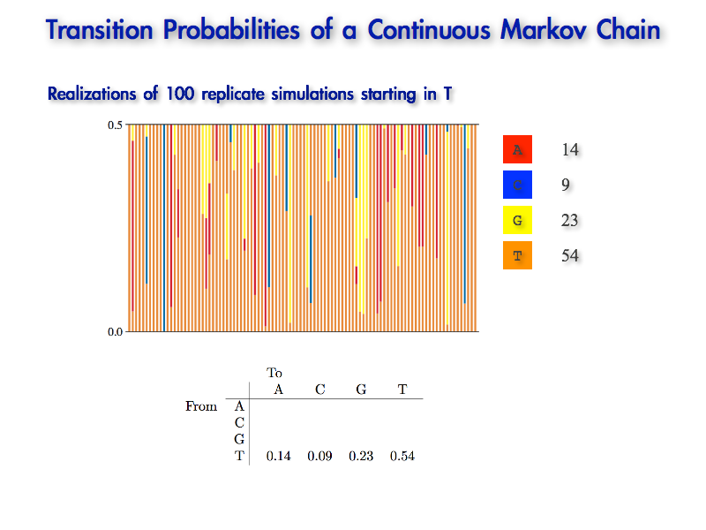
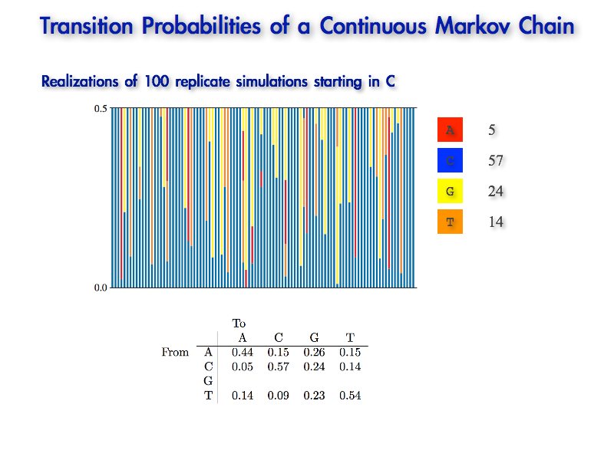
Scaling the Instantaneous Rate Matrix
Can we correctly estimate the true branch length used in our simulation?
The true branch length was
We compute the average number of changes for each starting state,
For simulations starting in C, the average number of changes was = 0.541

Slide 33
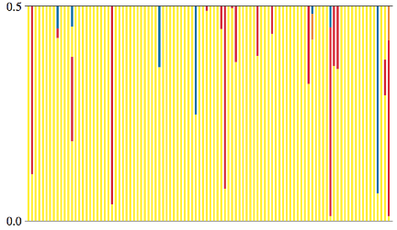
Scaling the Instantaneous Rate Matrix
Can we correctly estimate the true branch length used in our simulation?
The true branch length was
We compute the average number of changes for each starting state,
For simulations starting in G, the average number of changes was = 0.352

Slide 34
Scaling the Instantaneous Rate Matrix
Can we correctly estimate the true branch length used in our simulation?
The true branch length was
We compute the average number of changes for each starting state,
For simulations starting in T, the average number of changes was = 0.643

Slide 35
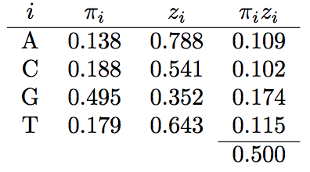
Scaling the Instantaneous Rate Matrix
Can we correctly estimate the true branch length used in our simulation?
The weighted sum of the average (expected) number of changes for all four states when the average of the Q matrix is 1...
0.138
0.788
0.109
0.188
0.541
0.102
0.495
0.352
0.174
0.179
0.643
0.155
probability of each starting state

Slide 36
Scaling the Instantaneous Rate Matrix
Can we correctly estimate the true branch length used in our simulation?
The weighted sum of the average (expected) number of changes for all four states when the average of the Q matrix is 1...
0.138
0.788
0.109
0.188
0.541
0.102
0.495
0.352
0.174
0.179
0.643
0.155
average number of changes away from each state

Slide 37
Scaling the Instantaneous Rate Matrix
Can we correctly estimate the true branch length used in our simulation?
The weighted sum of the average (expected) number of changes for all four states when the average of the Q matrix is 1...
0.138
0.788
0.109
0.188
0.541
0.102
0.495
0.352
0.174
0.179
0.643
0.155
product of
for each state

Slide 38
Scaling the Instantaneous Rate Matrix
Can we correctly estimate the true branch length used in our simulation?
The weighted sum of the average (expected) number of changes for all four states when the average of the Q matrix is 1...
0.138
0.788
0.109
0.188
0.541
0.102
0.495
0.352
0.174
0.179
0.643
0.155
0.500
sum of terms for all states

Slide 39
Scaling the Instantaneous Rate Matrix
Can we correctly estimate the true branch length used in our simulation?
The weighted sum of the average (expected) number of changes for all four states when the average of the Q matrix is 1...
0.138
0.788
0.109
0.188
0.541
0.102
0.495
0.352
0.174
0.179
0.643
0.155
0.500
i.e., the true branch length, in units expected (average) number of substitutions per site!

Slide 40
Scaling the Instantaneous Rate Matrix
Can we correctly estimate the true branch length used in our simulation?
The weighted sum of the average (expected) number of changes for all four states when the average of the Q matrix is 1...
0.138
0.788
0.109
0.188
0.541
0.102
0.495
0.352
0.174
0.179
0.643
0.155
0.500
i.e., the true branch length, in units expected (average) number of substitutions per site!
Scaling the instantaneous-rate matrix such that the average substitution rate is 1 therefore allows us to interpret the branch lengths, , in terms of the expected (average) number of substitutions per site.

Slide 41
Scaling the Instantaneous Rate Matrix
Can we correctly estimate the true branch length used in our simulation?
The weighted sum of the average (expected) number of changes for all four states when the average of the Q matrix is 2...
0.138
1.576
0.218
0.188
1.082
0.204
0.495
0.704
0.348
0.179
1.286
0.230
1.000
i.e., the branch length, in units expected number of substitutions per site is 2 x the true value!

Slide 42
Scaling the Instantaneous Rate Matrix
Can we correctly estimate the true branch length used in our simulation?
The weighted sum of the average (expected) number of changes for all four states when the average of the Q matrix is 2...
0.138
1.576
0.218
0.188
1.082
0.204
0.495
0.704
0.348
0.179
1.286
0.230
1.000
i.e., the branch length, in units expected number of substitutions per site is 2 x the true value!
Scaling the instantaneous-rate matrix such that the average substitution rate is 2 would require that we divide the estimated branch lengths by 2 in order to interpret the branch lengths, , in terms of the expected (average) number of substitutions per site.

Slide 43
Outline
I. A brief review of Continuous-Time Markov models
II. Stochastic models of nucleotide substitution
What’s the deal with time reversibility
Meet the GTR family
III. Accommodating among-site heterogeneity in the substitution process
Among-site variation in substitution rates
Among-site variation in substitution process
IV. Accommodating heterogeneity in the substitution process along the tree

Slide 44
Outline
I. A brief review of Continuous-Time Markov models
II. Stochastic models of nucleotide substitution
What’s the deal with time reversibility
Meet the GTR family
III. Accommodating among-site heterogeneity in the substitution process
Among-site variation in substitution rates
Among-site variation in substitution process
IV. Accommodating heterogeneity in the substitution process along the tree

Slide 45
Outline
I. A brief review of Continuous-Time Markov models
II. Stochastic models of nucleotide substitution
What’s the deal with time reversibility
Meet the GTR family
III. Accommodating among-site heterogeneity in the substitution process
Among-site variation in substitution rates
Among-site variation in substitution process
IV. Accommodating heterogeneity in the substitution process along the tree

Slide 46
Stochastic Models of Nucleotide Substitution
General Time Reversible models of nucleotide substitution
This family of CTMC models makes several simplifying assumptions:

Slide 47
Stochastic Models of Nucleotide Substitution
General Time Reversible models of nucleotide substitution
This family of CTMC models makes several simplifying assumptions:
the rate of the substitution process is constant across sites

Slide 48
Stochastic Models of Nucleotide Substitution
General Time Reversible models of nucleotide substitution
This family of CTMC models makes several simplifying assumptions:
the rate of the substitution process is constant across sites
the nature of the substitution process is constant across sites

Slide 49
Stochastic Models of Nucleotide Substitution
General Time Reversible models of nucleotide substitution
This family of CTMC models makes several simplifying assumptions:
the rate of the substitution process is constant across sites
the nature of the substitution process is constant across sites
sites are independent

Slide 50
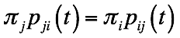
Time Reversibility
Most continuous-time Markov models assume time reversibility
The probability of a sequence of states visited forward in time is equal to the series of states visited in the reverse order

Slide 51
Time Reversibility
Most continuous-time Markov models assume time reversibility
The probability of a sequence of states visited forward in time is equal to the series of states visited in the reverse order
probability of starting state j
probability of ending in state i given starting state j and running over duration t

Slide 52
Time Reversibility
Most continuous-time Markov models assume time reversibility
The probability of a sequence of states visited forward in time is equal to the series of states visited in the reverse order
probability of starting state i
probability of ending in state j given starting state i and running over duration t

Slide 53
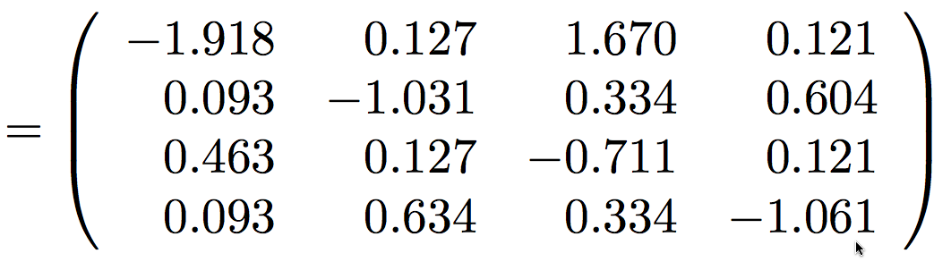
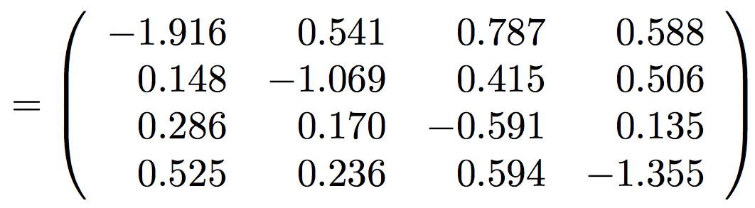
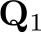
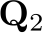
Time Reversibility
Most continuous-time Markov models assume time reversibility
Consider two rate matrices:
time irreversible
time reversible

Slide 54
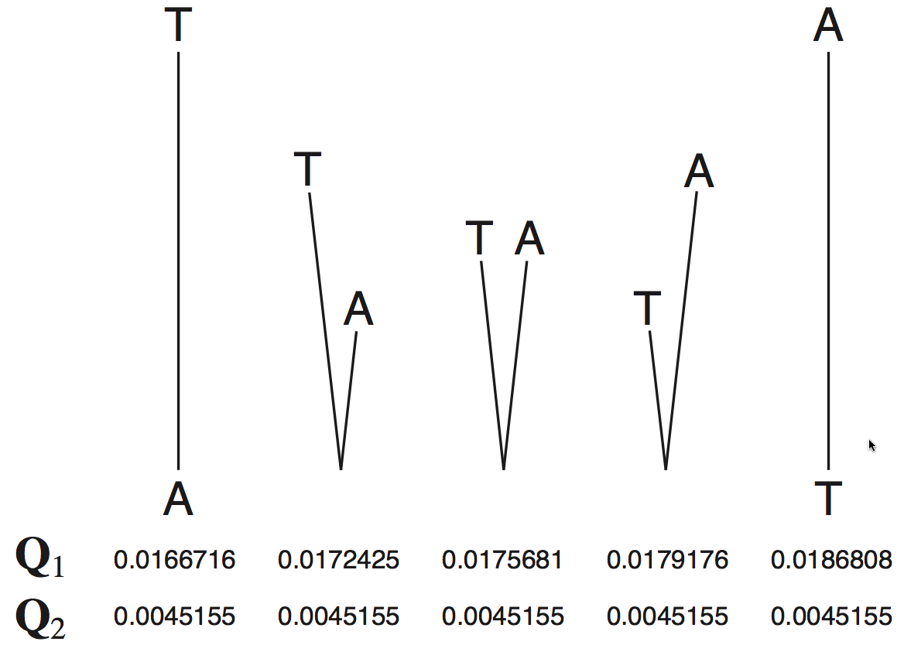
Time Reversibility
Most continuous-time Markov models assume time reversibility
Consider two rate matrices:
time irreversible
time reversible
time irreversible:
time reversible:

Slide 55
Time Reversibility
Most continuous-time Markov models assume time reversibility
Consider two rate matrices:
time irreversible
time reversible
time irreversible:
time reversible:

Slide 56
Time Reversibility
Most continuous-time Markov models assume time reversibility
Consider two rate matrices:
time irreversible
time reversible
time irreversible:
time reversible:

Slide 57
Time Reversibility
Most continuous-time Markov models assume time reversibility
Consider two rate matrices:
time irreversible
time reversible
time irreversible:
time reversible:

Slide 58
Time Reversibility
Most continuous-time Markov models assume time reversibility
Consider two rate matrices:
time irreversible
time reversible
time irreversible:
time reversible:

Slide 59
Time Reversibility
Most continuous-time Markov models assume time reversibility
Consider two rate matrices:
time irreversible
time reversible
time irreversible:
time reversible:

Slide 60
Time Reversibility
Most continuous-time Markov models assume time reversibility
The probability of a sequence of states visited forward in time is equal to the series of states visited in the reverse order
Time-reversible models allow an unrooted tree to be rooted anywhere without changing the probability of the data

Slide 61
Time Reversibility
Most continuous-time Markov models assume time reversibility
The probability of a sequence of states visited forward in time is equal to the series of states visited in the reverse order
Time-reversible models allow an unrooted tree to be rooted anywhere without changing the probability of the data
This allows us to perform inference under unrooted trees, which simplifies the space of trees that we have to evaluate, and the algorithms used to compute the likelihood

Slide 62
Outline
I. A brief review of Continuous-Time Markov models
II. Stochastic models of nucleotide substitution
What’s the deal with time reversibility
Meet the GTR family
III. Accommodating among-site heterogeneity in the substitution process
Among-site variation in substitution rates
Among-site variation in substitution process
IV. Accommodating heterogeneity in the substitution process along the tree

Slide 63
Outline
I. A brief review of Continuous-Time Markov models
II. Stochastic models of nucleotide substitution
What’s the deal with time reversibility
Meet the GTR family
III. Accommodating among-site heterogeneity in the substitution process
Among-site variation in substitution rates
Among-site variation in substitution process
IV. Accommodating heterogeneity in the substitution process along the tree

Slide 64
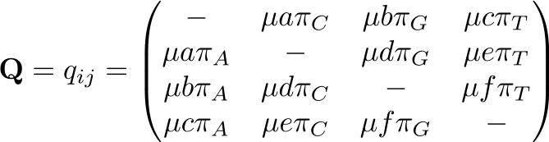
Stochastic Models of Nucleotide Substitution
Anatomy of General Time Reversible models
The instantaneous rates of change between states i and j, , depend both on the relative substitution rates, , (represented here as a–f), and also on the stationary frequencies of each state of the process,

Slide 65
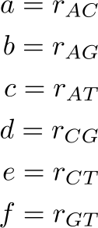
Stochastic Models of Nucleotide Substitution
Anatomy of General Time Reversible models
The instantaneous rates of change between states i and j, , depend both on the relative substitution rates, , (represented here as a–f), and also on the stationary frequencies of each state of the process,
The relative rates allow for possible biases in the instantaneous rates of change between each pair of states, , where:

Slide 66
Stochastic Models of Nucleotide Substitution
Anatomy of General Time Reversible models
The instantaneous rates of change between states i and j, , depend both on the relative substitution rates, , (represented here as a–f), and also on the stationary frequencies of each state of the process,
The relative rates allow for possible biases in the instantaneous rates of change between each pair of states, , where:

Slide 67
Stochastic Models of Nucleotide Substitution
Anatomy of General Time Reversible models
The instantaneous rates of change between states i and j, , depend both on the relative substitution rates, , (represented here as a–f), and also on the stationary frequencies of each state of the process,
The relative rates allow for possible biases in the instantaneous rates of change between each pair of states, , where:

Slide 68
Stochastic Models of Nucleotide Substitution
Anatomy of General Time Reversible models
The instantaneous rates of change between states i and j, , depend both on the relative substitution rates, , (represented here as a–f), and also on the stationary frequencies of each state of the process,
The relative rates allow for possible biases in the instantaneous rates of change between each pair of states, , where:

Slide 69
Stochastic Models of Nucleotide Substitution
Anatomy of General Time Reversible models
The instantaneous rates of change between states i and j, , depend both on the relative substitution rates, , (represented here as a–f), and also on the stationary frequencies of each state of the process,
The relative rates allow for possible biases in the instantaneous rates of change between each pair of states, , where:

Slide 70
Stochastic Models of Nucleotide Substitution
Anatomy of General Time Reversible models
The instantaneous rates of change between states i and j, , depend both on the relative substitution rates, , (represented here as a–f), and also on the stationary frequencies of each state of the process,
The relative rates allow for possible biases in the instantaneous rates of change between each pair of states, , where:

Slide 71
Stochastic Models of Nucleotide Substitution
Anatomy of General Time Reversible models
The instantaneous rates of change between states i and j, , depend both on the relative substitution rates, , (represented here as a–f), and also on the stationary frequencies of each state of the process,
The relative rates allow for possible biases in the instantaneous rates of change between each pair of states, , where:

Slide 72
Stochastic Models of Nucleotide Substitution
Anatomy of General Time Reversible models
The instantaneous rates of change between states i and j, , depend both on the relative substitution rates, , (represented here as a–f), and also on the stationary frequencies of each state of the process,
The relative rates allow for possible biases in the instantaneous rates of change between each pair of states,
The stationary frequencies are in the columns of the matrix, reflecting the fact that the instantaneous rate of change to state j depends on its stationary frequency,

Slide 73
Stochastic Models of Nucleotide Substitution
Anatomy of General Time Reversible models
The instantaneous rates of change between states i and j, , depend both on the relative substitution rates, , (represented here as a–f), and also on the stationary frequencies of each state of the process,
The relative rates allow for possible biases in the instantaneous rates of change between each pair of states,
The stationary frequencies are in the columns of the matrix, reflecting the fact that the instantaneous rate of change to state j depends on its stationary frequency,

Slide 74
Stochastic Models of Nucleotide Substitution
Anatomy of General Time Reversible models
The instantaneous rates of change between states i and j, , depend both on the relative substitution rates, , (represented here as a–f), and also on the stationary frequencies of each state of the process,
The relative rates allow for possible biases in the instantaneous rates of change between each pair of states,
The stationary frequencies are in the columns of the matrix, reflecting the fact that the instantaneous rate of change to state j depends on its stationary frequency,

Slide 75
Stochastic Models of Nucleotide Substitution
Anatomy of General Time Reversible models
The instantaneous rates of change between states i and j, , depend both on the relative substitution rates, , (represented here as a–f), and also on the stationary frequencies of each state of the process,
The relative rates allow for possible biases in the instantaneous rates of change between each pair of states,
The stationary frequencies are in the columns of the matrix, reflecting the fact that the instantaneous rate of change to state j depends on its stationary frequency,

Slide 76
Stochastic Models of Nucleotide Substitution
Anatomy of General Time Reversible models
The instantaneous rates of change between states i and j, , depend both on the relative substitution rates, , (represented here as a–f), and also on the stationary frequencies of each state of the process,
The relative rates allow for possible biases in the instantaneous rates of change between each pair of states,
The stationary frequencies are in the columns of the matrix, reflecting the fact that the instantaneous rate of change to state j depends on its stationary frequency,

Slide 77
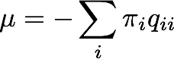
Stochastic Models of Nucleotide Substitution
Anatomy of General Time Reversible models
The instantaneous rates of change between states i and j, , depend both on the relative substitution rates, , (represented here as a–f), and also on the stationary frequencies of each state of the process,
The relative rates allow for possible biases in the instantaneous rates of change between each pair of states,
The stationary frequencies are in the columns of the matrix, reflecting the fact that the instantaneous rate of change to state i depends on its stationary frequency,
Recall that the average rate of substitution is scaled to be one:

Slide 78
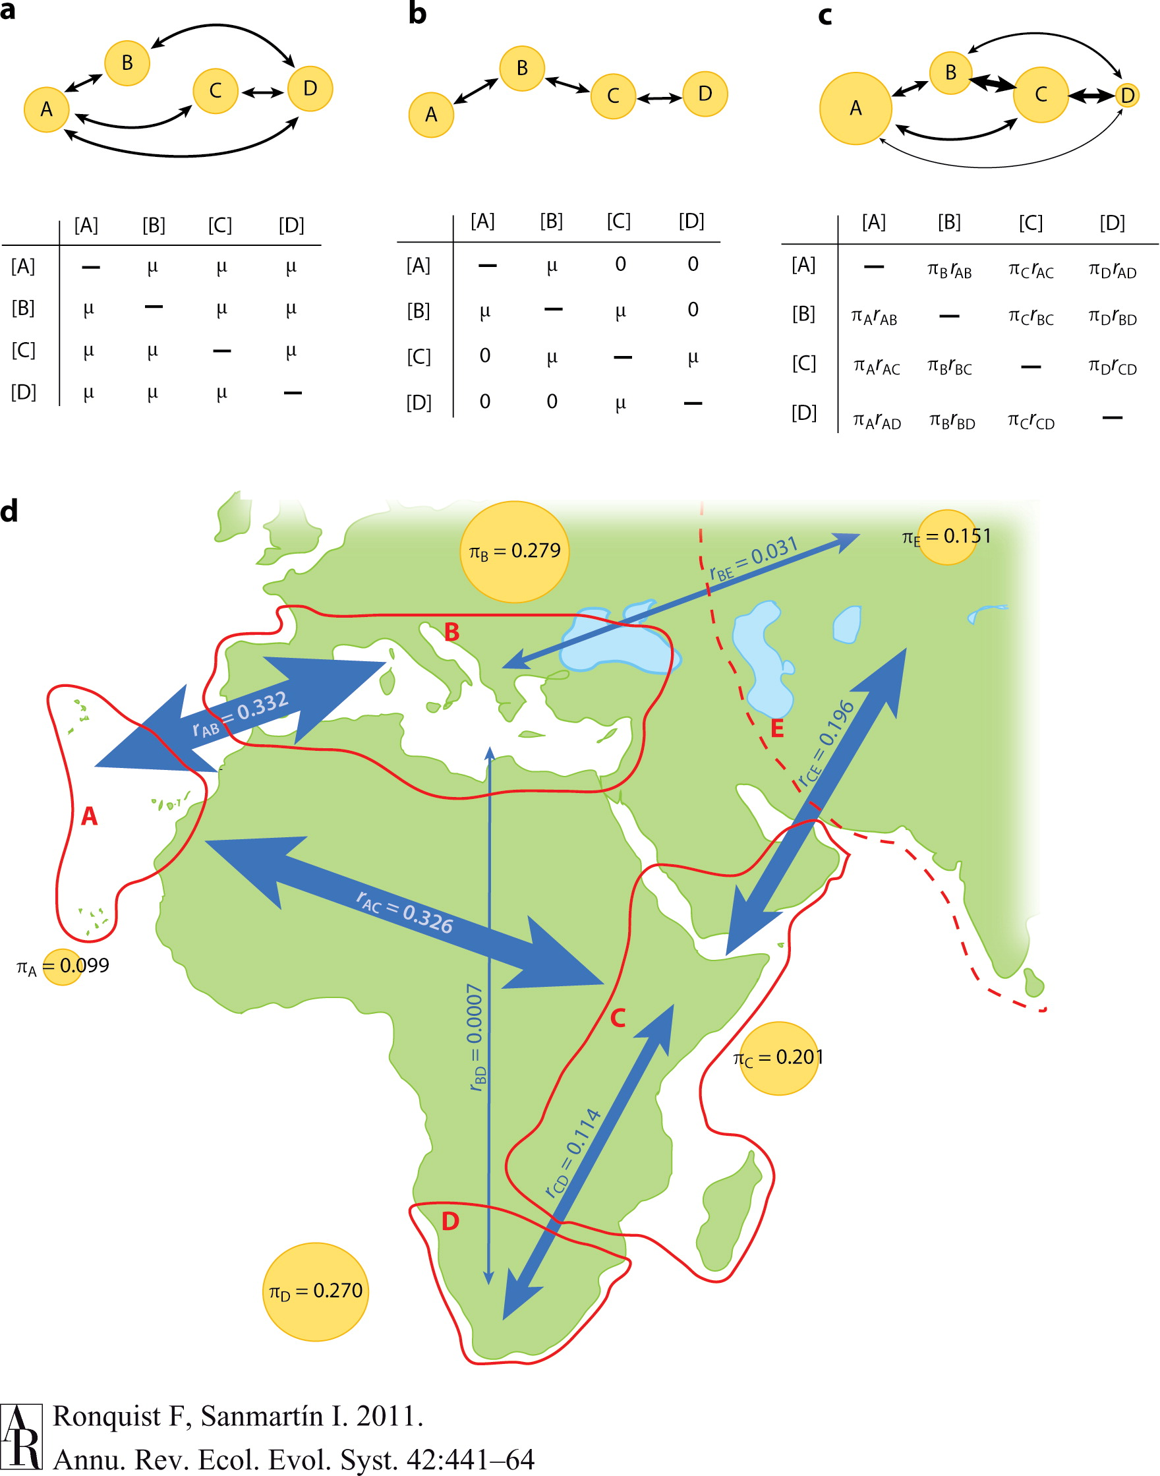
Stochastic Models of Nucleotide Substitution
A phylogeographic intuition on relative rates and stationary frequencies
Ronquist and Sanmartin used a GTR model to study migrations of plants between parts of the old world.
Exchangeabilities correspond to the intensities of biotic exchange (thickness of arrows)
Equilibrium frequencies correspond to the carrying capacities of the regions

Slide 79
Stochastic Models of Nucleotide Substitution
The Jukes and Cantor, 1969 (JC69) substitution model
Relative rates of change between each pair of states i and j, , are assumed to be equal, therefore: a = b = c = d = e = f

Slide 80
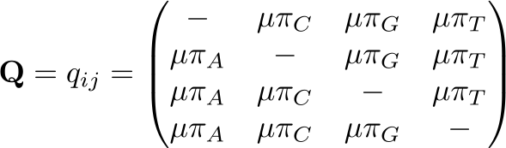
Stochastic Models of Nucleotide Substitution
The Jukes and Cantor, 1969 (JC69) substitution model
Relative rates of change between each pair of states i and j, , are assumed to be equal, therefore: a = b = c = d = e = f

Slide 81
Stochastic Models of Nucleotide Substitution
The Jukes and Cantor, 1969 (JC69) substitution model
Relative rates of change between each pair of states i and j, , are assumed to be equal, therefore: a = b = c = d = e = f
The stationary frequencies of each state are assumed to be equal, therefore:

Slide 82
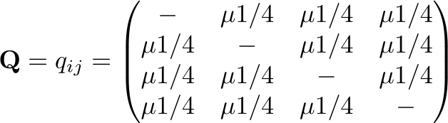
Stochastic Models of Nucleotide Substitution
The Jukes and Cantor, 1969 (JC69) substitution model
Relative rates of change between each pair of states i and j, , are assumed to be equal, therefore: a = b = c = d = e = f
The stationary frequencies of each state are assumed to be equal, therefore:

Slide 83
Stochastic Models of Nucleotide Substitution
The Jukes and Cantor, 1969 (JC69) substitution model
Relative rates of change between each pair of states i and j, , are assumed to be equal, therefore: a = b = c = d = e = f
The stationary frequencies of each state are assumed to be equal, therefore:
A free parameter is a parameter that is free to vary (it is estimated from the data)

Slide 84
Stochastic Models of Nucleotide Substitution
The Jukes and Cantor, 1969 (JC69) substitution model
Relative rates of change between each pair of states i and j, , are assumed to be equal, therefore: a = b = c = d = e = f
The stationary frequencies of each state are assumed to be equal, therefore:
A free parameter is a parameter that is free to vary (it is estimated from the data)
How many free parameters are there in the JC69 substitution model?

Slide 85
Stochastic Models of Nucleotide Substitution
The Jukes and Cantor, 1969 (JC69) substitution model
Relative rates of change between each pair of states i and j, , are assumed to be equal, therefore: a = b = c = d = e = f
The stationary frequencies of each state are assumed to be equal, therefore:
A free parameter is a parameter that is free to vary (it is estimated from the data)
How many free parameters are there in the JC69 substitution model?

Slide 86
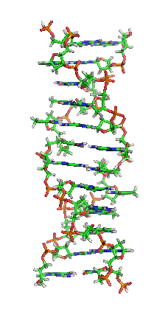
Stochastic Models of Nucleotide Substitution
Biology motivates the extension of models
DNA
Purines
Pyrimidines
Adenine
Thymine
Guanine
Cytosine

Slide 87
Stochastic Models of Nucleotide Substitution
Biology motivates the extension of models
DNA
Purines
Pyrimidines
Adenine
Thymine
transition substitutions
Guanine
Cytosine

Slide 88
Stochastic Models of Nucleotide Substitution
Biology motivates the extension of models
DNA
Purines
Pyrimidines
Adenine
Thymine
transversion substitutions
Guanine
Cytosine

Slide 89
Stochastic Models of Nucleotide Substitution
Biology motivates the extension of models
The molecular structure makes transitions more probable than transversions
DNA
Purines
Pyrimidines
Adenine
Thymine
transitions > transversions
Guanine
Cytosine

Slide 90
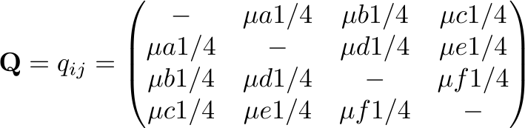
Stochastic Models of Nucleotide Substitution
The Kimura, 1980 (K80) substitution model
The stationary frequencies of all states are still assumed to be equal

Slide 91
Stochastic Models of Nucleotide Substitution
The Kimura, 1980 (K80) substitution model
The stationary frequencies of all states are still assumed to be equal
The relative rates accommodate possible bias in the instantaneous rates of transition and transversion substitutions
Purine
Pyrimidine
A
T
G
C

Slide 92
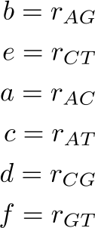
Stochastic Models of Nucleotide Substitution
The Kimura, 1980 (K80) substitution model
The stationary frequencies of all states are still assumed to be equal
The relative rates accommodate possible bias in the instantaneous rates of transition and transversion substitutions
Purine
Pyrimidine
A
T
G
C

Slide 93
Stochastic Models of Nucleotide Substitution
The Kimura, 1980 (K80) substitution model
The stationary frequencies of all states are still assumed to be equal
The relative rates accommodate possible bias in the instantaneous rates of transition and transversion substitutions
Purine
Pyrimidine
A
T
G
C

Slide 94
Stochastic Models of Nucleotide Substitution
The Kimura, 1980 (K80) substitution model
The stationary frequencies of all states are still assumed to be equal
The relative rates accommodate possible bias in the instantaneous rates of transition and transversion substitutions
Purine
Pyrimidine
A
T
G
C

Slide 95
Stochastic Models of Nucleotide Substitution
The Kimura, 1980 (K80) substitution model
The stationary frequencies of all states are still assumed to be equal
The relative rates accommodate possible bias in the instantaneous rates of transition and transversion substitutions
Purine
Pyrimidine
A
T
G
C

Slide 96
Stochastic Models of Nucleotide Substitution
The Kimura, 1980 (K80) substitution model
The stationary frequencies of all states are still assumed to be equal
The relative rates accommodate possible bias in the instantaneous rates of transition and transversion substitutions
Purine
Pyrimidine
A
T
G
C

Slide 97
Stochastic Models of Nucleotide Substitution
The Kimura, 1980 (K80) substitution model
The stationary frequencies of all states are still assumed to be equal
The relative rates accommodate possible bias in the instantaneous rates of transition and transversion substitutions
Purine
Pyrimidine
A
T
G
C

Slide 98
Stochastic Models of Nucleotide Substitution
The Kimura, 1980 (K80) substitution model
The stationary frequencies of all states are still assumed to be equal
The relative rates accommodate possible bias in the instantaneous rates of transition and transversion substitutions
Under this model, all transition substitutions are assumed to have the same rate (b = e) and all transversion substitutions are assumed to have the same rate (a = c = d = f)

Slide 99
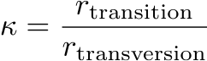
Stochastic Models of Nucleotide Substitution
The Kimura, 1980 (K80) substitution model
The stationary frequencies of all states are still assumed to be equal
The relative rates accommodate possible bias in the instantaneous rates of transition and transversion substitutions
Under this model, all transition substitutions are assumed to have the same rate (b = e) and all transversion substitutions are assumed to have the same rate (a = c = d = f) BUT we allow for a possible bias in the relative rate of transitions and transversions by introducing a new parameter, :

Slide 100
Stochastic Models of Nucleotide Substitution
The Kimura, 1980 (K80) substitution model
The stationary frequencies of all states are still assumed to be equal
The relative rates accommodate possible bias in the instantaneous rates of transition and transversion substitutions
Under this model, all transition substitutions are assumed to have the same rate (b = e) and all transversion substitutions are assumed to have the same rate (a = c = d = f) BUT we allow for a possible bias in the relative rate of transitions and transversions by introducing a new parameter, :

Slide 101
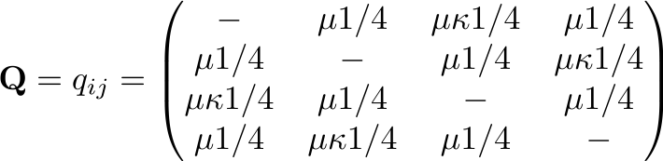
Stochastic Models of Nucleotide Substitution
The Kimura, 1980 (K80) substitution model
The stationary frequencies of all states are still assumed to be equal
The relative rates accommodate possible bias in the instantaneous rates of transition and transversion substitutions
Under this model, all transition substitutions are assumed to have the same rate (b = e) and all transversion substitutions are assumed to have the same rate (a = c = d = f) BUT we allow for a possible bias in the relative rate of transitions and transversions by introducing a new parameter, :

Slide 102
Stochastic Models of Nucleotide Substitution
The Kimura, 1980 (K80) substitution model
The stationary frequencies of all states are still assumed to be equal
The relative rates accommodate possible bias in the instantaneous rates of transition and transversion substitutions
Under this model, all transition substitutions are assumed to have the same rate (b = e) and all transversion substitutions are assumed to have the same rate (a = c = d = f) BUT we allow for a possible bias in the relative rate of transitions and transversions by introducing a new parameter, :
How many free parameters are there in the K80 substitution model?

Slide 103
Stochastic Models of Nucleotide Substitution
Paparazzi time: Name that model!

Slide 104
Stochastic Models of Nucleotide Substitution
The Kimura, 1980 (K80) substitution model

Slide 105
Stochastic Models of Nucleotide Substitution
The Jukes and Cantor, 1969 (JC69) substitution model
Relative rates of change between each pair of states i and j, , are assumed to be equal, therefore: a = b = c = d = e = f
The stationary frequencies of each state are assumed to be equal, therefore:

Slide 106
Stochastic Models of Nucleotide Substitution
The Jukes and Cantor, 1969 (JC69) substitution model
Relative rates of change between each pair of states i and j, , are assumed to be equal, therefore: a = b = c = d = e = f
The stationary frequencies of each state are assumed to be equal, therefore:

Slide 107

Stochastic Models of Nucleotide Substitution
We all know that's complete bullshit!
The Jukes and Cantor, 1969 (JC69) substitution model
Relative rates of change between each pair of states i and j, , are assumed to be equal, therefore: a = b = c = d = e = f
The stationary frequencies of each state are assumed to be equal, therefore:

Slide 108
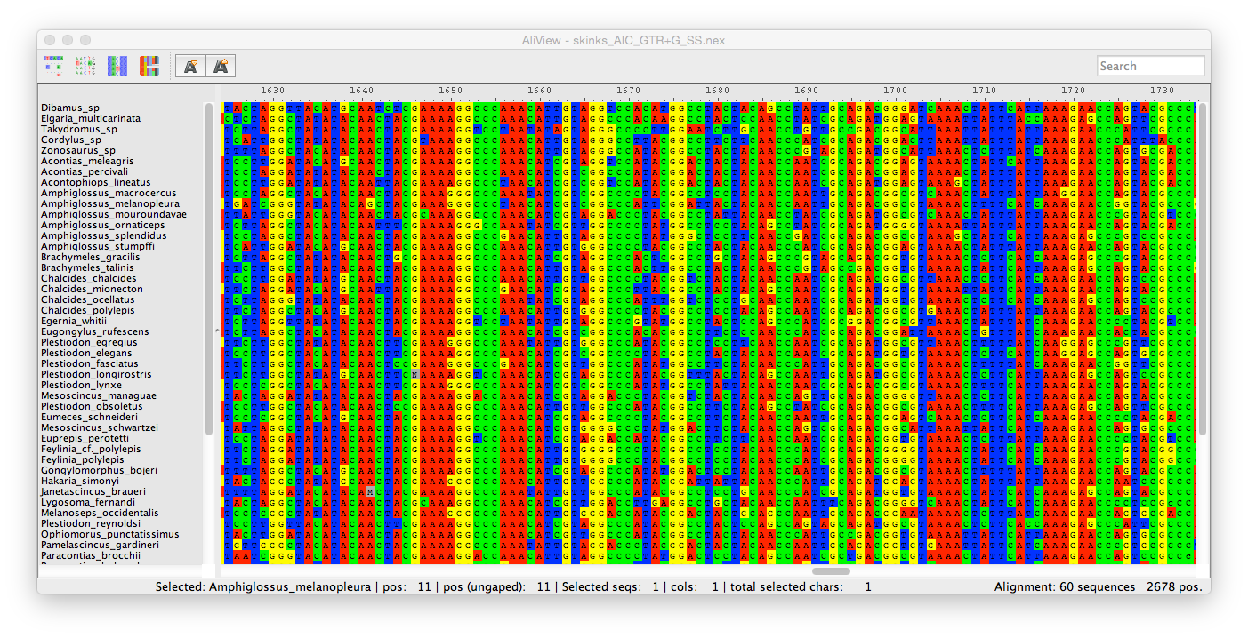
Stochastic Models of Nucleotide Substitution
Biology motivates the extension of models
A = 49,708÷151,015 = 32.9%
G = 25,162÷151,015 = 16.7%
A ≠ C ≠ G ≠ T ≠ 0.25
C = 41,073÷151,015 = 27.2%
T = 34,972÷151,015 = 23.2%

Slide 109
Stochastic Models of Nucleotide Substitution
The Felsenstein, 1981 (F81) substitution model
Like the JC69 model, all relative rates are assumed to be equal, therefore: a = b = c = d = e = f

Slide 110
Stochastic Models of Nucleotide Substitution
The Felsenstein, 1981 (F81) substitution model
Like the JC69 model, all relative rates are assumed to be equal, therefore: a = b = c = d = e = f
The stationary frequencies of each state are allowed to be unequal by adding a parameter for each state:

Slide 111
Stochastic Models of Nucleotide Substitution
The Felsenstein, 1981 (F81) substitution model
Like the JC69 model, all relative rates are assumed to be equal, therefore: a = b = c = d = e = f
The stationary frequencies of each state are allowed to be unequal by adding a parameter for each state:

Slide 112
Stochastic Models of Nucleotide Substitution
The Felsenstein, 1981 (F81) substitution model
Like the JC69 model, all relative rates are assumed to be equal, therefore: a = b = c = d = e = f
The stationary frequencies of each state are allowed to be unequal by adding a parameter for each state:

Slide 113
Stochastic Models of Nucleotide Substitution
The Felsenstein, 1981 (F81) substitution model
Like the JC69 model, all relative rates are assumed to be equal, therefore: a = b = c = d = e = f
The stationary frequencies of each state are allowed to be unequal by adding a parameter for each state:

Slide 114
Stochastic Models of Nucleotide Substitution
The Felsenstein, 1981 (F81) substitution model
Like the JC69 model, all relative rates are assumed to be equal, therefore: a = b = c = d = e = f
The stationary frequencies of each state are allowed to be unequal by adding a parameter for each state:

Slide 115
Stochastic Models of Nucleotide Substitution
Paparazzi time: Name that model!

Slide 116
Stochastic Models of Nucleotide Substitution
Paparazzi time: Name that model!

Slide 117
Stochastic Models of Nucleotide Substitution
Paparazzi time: Name that model!

Slide 118
Stochastic Models of Nucleotide Substitution
The Felsenstein, 1981 (F81) substitution model
Like the JC69 model, all relative rates are assumed to be equal, therefore: a = b = c = d = e = f
The stationary frequencies of each state are allowed to be unequal by adding a parameter for each state:
How many free parameters are there in the F81 substitution model?

Slide 119
Stochastic Models of Nucleotide Substitution
The Hasegawa, Kishino, Yano, 1985 (HKY85) substitution model
Combines features of the K80 and F81 substitution models

Slide 120
Stochastic Models of Nucleotide Substitution
The Hasegawa, Kishino, Yano, 1985 (HKY85) substitution model
Combines features of the K80 and F81 substitution models
Like the K80 model, all transitions are assumed to have the same rate (b = e) and all transversion are assumed to have the same rate (a = c = d = f) and accommodates a possible bias in the transition/transversion rate ratio,

Slide 121
Stochastic Models of Nucleotide Substitution
The Hasegawa, Kishino, Yano, 1985 (HKY85) substitution model
Combines features of the K80 and F81 substitution models
Like the K80 model, all transitions are assumed to have the same rate (b = e) and all transversion are assumed to have the same rate (a = c = d = f) and accommodates a possible bias in the transition/transversion rate ratio,

Slide 122
Stochastic Models of Nucleotide Substitution
The Hasegawa, Kishino, Yano, 1985 (HKY85) substitution model
Combines features of the K80 and F81 substitution models
Like the K80 model, all transitions are assumed to have the same rate (b = e) and all transversion are assumed to have the same rate (a = c = d = f) and accommodates a possible bias in the transition/transversion rate ratio,
Like the F81 model, stationary frequencies are free to vary by including a parameter for each state:

Slide 123
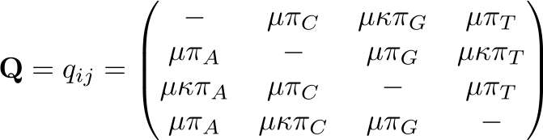
Stochastic Models of Nucleotide Substitution
The Hasegawa, Kishino, Yano, 1985 (HKY85) substitution model
Combines features of the K80 and F81 substitution models
Like the K80 model, all transitions are assumed to have the same rate (b = e) and all transversion are assumed to have the same rate (a = c = d = f) and accommodates a possible bias in the transition/transversion rate ratio,
Like the F81 model, stationary frequencies are free to vary by including a parameter for each state:

Slide 124
Stochastic Models of Nucleotide Substitution
The Hasegawa, Kishino, Yano, 1985 (HKY85) substitution model
Combines features of the K80 and F81 substitution models
Like the K80 model, all transitions are assumed to have the same rate (b = e) and all transversion are assumed to have the same rate (a = c = d = f) and accommodates a possible bias in the transition/transversion rate ratio,
Like the F81 model, stationary frequencies are free to vary by including a parameter for each state:

Slide 125
Stochastic Models of Nucleotide Substitution
The Hasegawa, Kishino, Yano, 1985 (HKY85) substitution model
Combines features of the K80 and F81 substitution models
Like the K80 model, all transitions are assumed to have the same rate (b = e) and all transversion are assumed to have the same rate (a = c = d = f) and accommodates a possible bias in the transition/transversion rate ratio,
Like the F81 model, stationary frequencies are free to vary by including a parameter for each state:

Slide 126
Stochastic Models of Nucleotide Substitution
The Hasegawa, Kishino, Yano, 1985 (HKY85) substitution model
Combines features of the K80 and F81 substitution models
Like the K80 model, all transitions are assumed to have the same rate (b = e) and all transversion are assumed to have the same rate (a = c = d = f) and accommodates a possible bias in the transition/transversion rate ratio,
Like the F81 model, stationary frequencies are free to vary by including a parameter for each state:

Slide 127
Stochastic Models of Nucleotide Substitution
Paparazzi time: Name that model!

Slide 128
Stochastic Models of Nucleotide Substitution
The Hasegawa, Kishino, Yano, 1985 (HKY85) substitution model
Combines features of the K80 and F81 substitution models
Like the K80 model, all transitions are assumed to have the same rate (b = e) and all transversion are assumed to have the same rate (a = c = d = f) and accommodates a possible bias in the transition/transversion rate ratio,
Like the F81 model, stationary frequencies are free to vary by including a parameter for each state:
How many free parameters are there in the HKY85 substitution model?

Slide 129
Stochastic Models of Nucleotide Substitution
The Hasegawa, Kishino, Yano, 1985 (HKY85) substitution model
Combines features of the K80 and F81 substitution models
Like the K80 model, all transitions are assumed to have the same rate (b = e) and all transversion are assumed to have the same rate (a = c = d = f) and accommodates a possible bias in the transition/transversion rate ratio,
Like the F81 model, stationary frequencies are free to vary by including a parameter for each state:
How many free parameters are there in the HKY85 substitution model?

Slide 130
Stochastic Models of Nucleotide Substitution
The General Time Reversible (GTR) substitution model
Allows all six relative substitution rates (a – f) to vary

Slide 131
Stochastic Models of Nucleotide Substitution
The General Time Reversible (GTR) substitution model
Allows all six relative substitution rates (a – f) to vary
Like the F81 and HKY85 models, stationary frequencies are free to vary

Slide 132
Stochastic Models of Nucleotide Substitution
Paparazzi time: Name that model!
Allows all six relative substitution rates (a – f) to vary
Like the F81 and HKY85 models, stationary frequencies are free to vary
How many free parameters are there in the GTR substitution model?

Slide 133
Stochastic Models of Nucleotide Substitution
The General Time Reversible (GTR) substitution model
Allows all six relative substitution rates (a – f) to vary
Like the F81 and HKY85 models, stationary frequencies are free to vary
How many free parameters are there in the GTR substitution model?

Slide 134
Stochastic Models of Nucleotide Substitution
Members of the GTR substitution model family are hierarchically related
JC69
We can move from a simpler to a more general model by relaxing a constraint

Slide 135
Stochastic Models of Nucleotide Substitution
Members of the GTR substitution model family are hierarchically related
F81
allow stationary frequencies to vary
JC69
We can move from a simpler to a more general model by relaxing a constraint

Slide 136
Stochastic Models of Nucleotide Substitution
Members of the GTR substitution model family are hierarchically related
K80
F81
allow ti & tv rates to vary
allow stationary frequencies to vary
JC69
We can move from a simpler to a more general model by relaxing a constraint

Slide 137
Stochastic Models of Nucleotide Substitution
Members of the GTR substitution model family are hierarchically related
HKY85
allow both ti:tv rate bias and unequal stationary frequencies
K80
F81
allow ti & tv rates to vary
allow stationary frequencies to vary
JC69
We can move from a simpler to a more general model by relaxing a constraint

Slide 138
Stochastic Models of Nucleotide Substitution
Members of the GTR substitution model family are hierarchically related
GTR
allow all relative rates to vary
HKY85
allow both ti:tv rate bias and unequal stationary frequencies
K80
F81
allow ti & tv rates to vary
allow stationary frequencies to vary
JC69
We can move from a simpler to a more general model by relaxing a constraint

Slide 139
Stochastic Models of Nucleotide Substitution
Members of the GTR substitution model family are hierarchically related
GTR
We can move from a more general model to a simpler model by imposing a constraint

Slide 140
Stochastic Models of Nucleotide Substitution
Members of the GTR substitution model family are hierarchically related
GTR
assume only the relative ti:tv rates to vary
HKY85
We can move from a more general model to a simpler model by imposing a constraint

Slide 141
Stochastic Models of Nucleotide Substitution
Members of the GTR substitution model family are hierarchically related
GTR
assume only the relative ti:tv rates to vary
HKY85
assume all relative substitution rates are equal
F81
We can move from a more general model to a simpler model by imposing a constraint

Slide 142
Stochastic Models of Nucleotide Substitution
Members of the GTR substitution model family are hierarchically related
GTR
assume only the relative ti:tv rates to vary
HKY85
assume all stationary frequencies are equal
assume all relative substitution rates are equal
K80
F81
We can move from a more general model to a simpler model by imposing a constraint

Slide 143
Stochastic Models of Nucleotide Substitution
Members of the GTR substitution model family are hierarchically related
GTR
assume only the relative ti:tv rates to vary
HKY85
assume all stationary frequencies are equal
assume all relative substitution rates are equal
K80
F81
assume all stationary frequencies are equal
JC69
We can move from a more general model to a simpler model by imposing a constraint

Slide 144
Stochastic Models of Nucleotide Substitution
Members of the GTR substitution model family are hierarchically related
GTR
assume only the relative ti:tv rates to vary
HKY85
assume all stationary frequencies are equal
assume all relative substitution rates are equal
K80
F81
assume relative ti:tv rates rates are equal
assume all stationary frequencies are equal
JC69
We can move from a more general model to a simpler model by imposing a constraint

Slide 145
Stochastic Models of Nucleotide Substitution
Members of the GTR substitution model family are hierarchically related
GTR
assume only the relative ti:tv rates to vary
HKY85
assume all stationary frequencies are equal
assume all relative substitution rates are equal
K80
F81
assume relative ti:tv rates rates are equal
assume all stationary frequencies are equal
JC69
We can move from a more general model to a simpler model by imposing a constraint
The differences between models allow us to test hypotheses (to learn) about our data

Slide 146
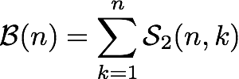
Stochastic Models of Nucleotide Substitution
How many members of the GTR model family are there?
The total number of unique models for k relative-rate parameters is described by Bell numbers:

Slide 147
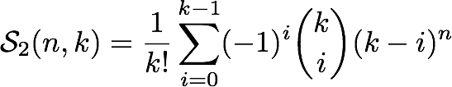
Stochastic Models of Nucleotide Substitution
How many members of the GTR model family are there?
The total number of unique models for k relative-rate parameters is described by Bell numbers:
which is the sum of the Sterling numbers of the second kind:

Slide 148
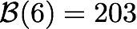
Stochastic Models of Nucleotide Substitution
How many members of the GTR model family are there?
The total number of unique models for k relative-rate parameters is described by Bell numbers:
which is the sum of the Sterling numbers of the second kind:
For K = 6:

Slide 149
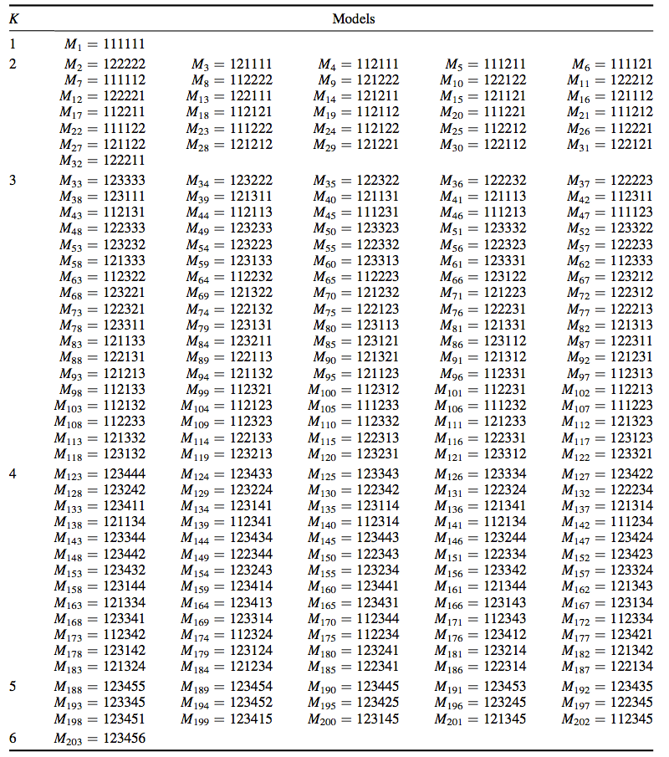
Stochastic Models of Nucleotide Substitution
How many members of the GTR model family are there?

Slide 150
Stochastic Models of Nucleotide Substitution
Limitations of the GTR model family:
Homogeneity along the sequence and along the tree
If the process were homogeneous along the sequence: all sites would be similar in their ACGT composition, and in the number of substitutions they have undergone
If the process were homogeneous along the tree, the sequences would all be similar in their ACGT composition

Slide 151
Stochastic Models of Nucleotide Substitution
Limitations of the GTR model family:
Homogeneity along the sequence and along the tree
If the process were homogeneous along the sequence: all sites would be similar in their ACGT composition, and in the number of substitutions they have undergone
If the process were homogeneous along the tree, the sequences would all be similar in their ACGT composition
Failure to account for heterogeneity along the tree and along the sequence can result in erroneous tree topologies, incorrect inferences of selection, etc.

Slide 152
Outline
I. A brief review of Continuous-Time Markov models
II. Stochastic models of nucleotide substitution
What’s the deal with time reversibility
Meet the GTR family
III. Accommodating among-site heterogeneity in the substitution process
Among-site variation in substitution rates
Among-site variation in substitution process
IV. Accommodating heterogeneity in the substitution process along the tree

Slide 153
Outline
I. A brief review of Continuous-Time Markov models
II. Stochastic models of nucleotide substitution
What’s the deal with time reversibility
Meet the GTR family
III. Accommodating among-site heterogeneity in the substitution process
Among-site variation in substitution rates
Among-site variation in substitution process
IV. Accommodating heterogeneity in the substitution process along the tree

Slide 154
Stochastic Models of Nucleotide Substitution
General Time Reversible models of nucleotide substitution
This family of CTMC models makes several simplifying assumptions:
the rate of the substitution process is constant across sites
the nature of the substitution process is constant across sites
sites are independent

Slide 155
Stochastic Models of Nucleotide Substitution
General Time Reversible models of nucleotide substitution
This family of CTMC models makes several simplifying assumptions:
the rate of the substitution process is constant across sites
the nature of the substitution process is constant across sites
sites are independent

Slide 156
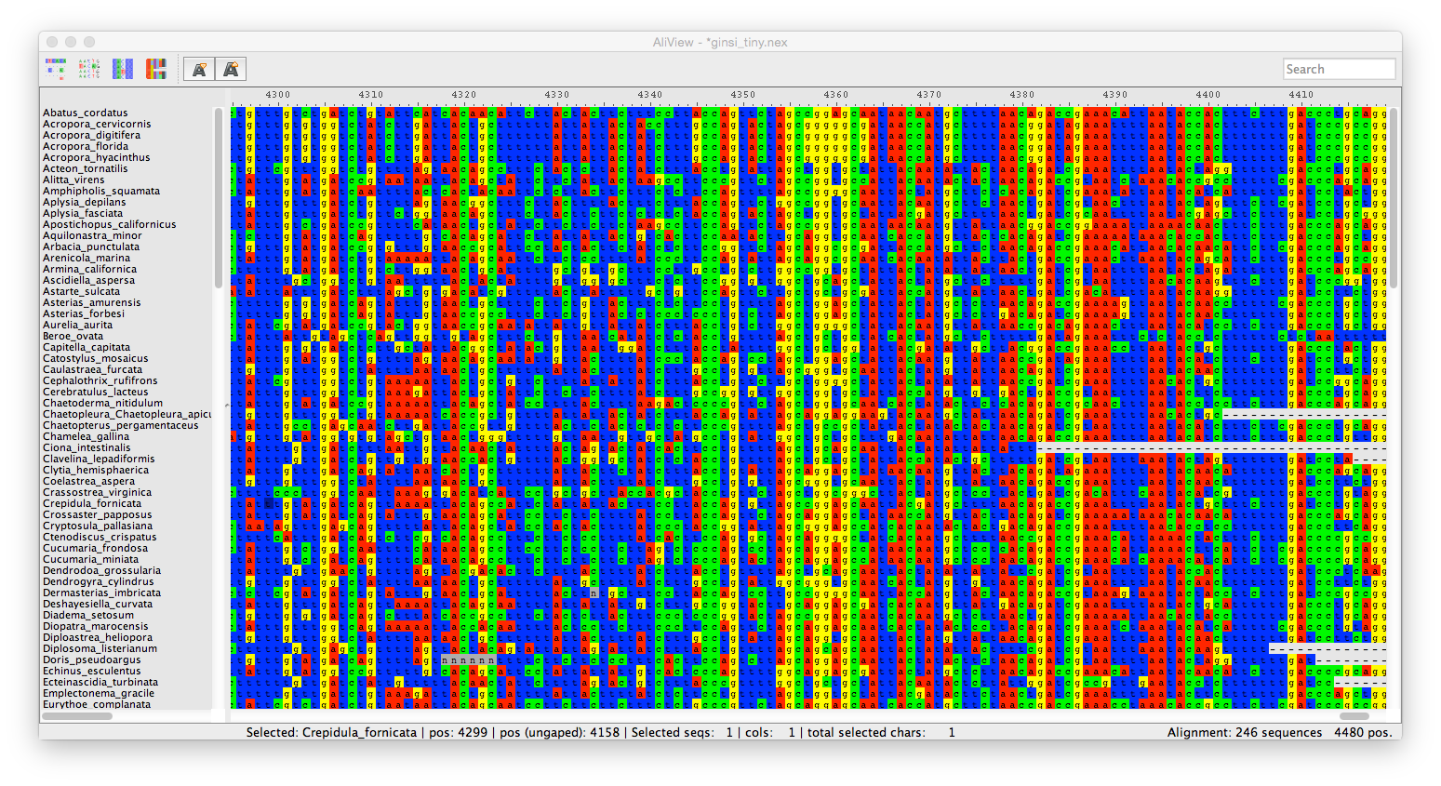
Accommodating Among Site Rate Variation
Standard models assume that the substitution rate is constant across sites
low-rate site

Slide 157
Accommodating Among Site Rate Variation
Standard models assume that the substitution rate is constant across sites
low-rate site

Slide 158
Accommodating Among Site Rate Variation
Standard models assume that the substitution rate is constant across sites
high-rate site

Slide 159
Accommodating Among Site Rate Variation
Standard models assume that the substitution rate is constant across sites
low-rate site

Slide 160
Accommodating Among Site Rate Variation
Standard models assume that the substitution rate is constant across sites
low-rate site

Slide 161
Accommodating Among Site Rate Variation
Standard models assume that the substitution rate is constant across sites
high-rate site

Slide 162
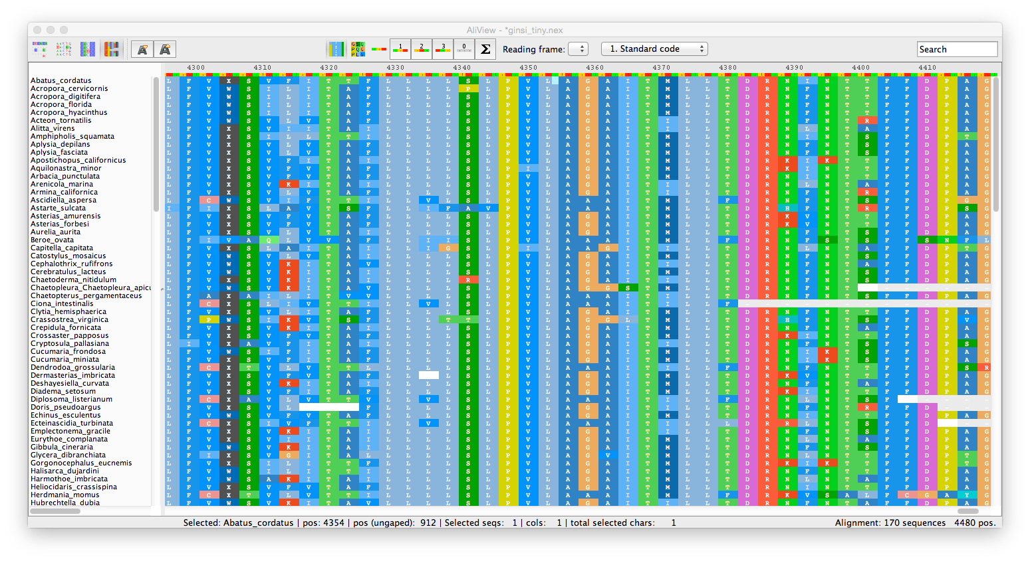
Accommodating Among Site Rate Variation
Standard models assume that the substitution rate is constant across sites
The substitution rates may differ between sites at different codon positions of protein-coding genes

Slide 163
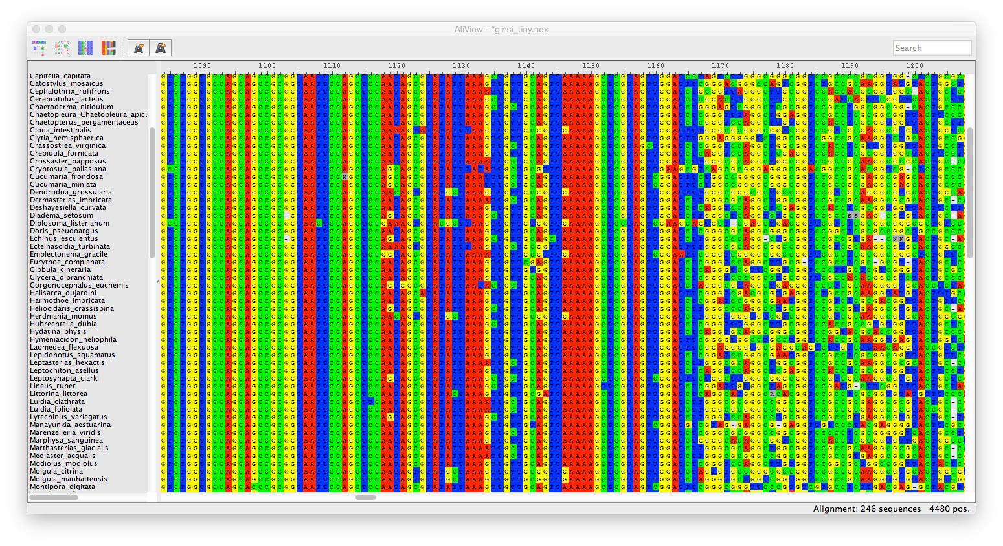
Accommodating Among Site Rate Variation
Standard models assume that the substitution rate is constant across sites
low-rate region

Slide 164
Accommodating Among Site Rate Variation
Standard models assume that the substitution rate is constant across sites
low-rate region
high-rate region

Slide 165
Accommodating Among Site Rate Variation
Standard models assume that the substitution rate is constant across sites
stem region
loop region

Slide 166
Accommodating Among Site Rate Variation
Standard models assume that the substitution rate is constant across sites
The substitution rates may differ between stem and loop regions of ribosomal gene regions

Slide 167
Accommodating Among Site Rate Variation
Standard models assume that the substitution rate is constant across sites
Variation in substitution rates across sites is a prevalent feature of empirical datasets

Slide 168
Accommodating Among Site Rate Variation
Standard models assume that the substitution rate is constant across sites
Variation in substitution rates across sites is a prevalent feature of empirical datasets
Substitution rates may vary across because of:
systematic bias in mutation rates
biased Gene conversion
differences in functional constraints

Slide 169
Accommodating Among Site Rate Variation
Standard models assume that the substitution rate is constant across sites
Variation in substitution rates across sites is a prevalent feature of empirical datasets
Substitution rates may vary across because of:
systematic bias in mutation rates
biased Gene conversion
differences in functional constraints
Under simulation, failure to accommodate ASRV can cause biased estimates of:
tree topology
branch lengths
other substitution-model parameters

Slide 170
Accommodating Among Site Rate Variation
Biology motivates the extension of models
Substitution rates are reflected in the branch lengths of the tree
the relative rate at a site proportionately stretches or compresses the branch lengths
A
C
A
C
A
C
B
D
B
D
B
D
low-rate site
intermediate-rate site
high-rate site

Slide 171
Accommodating Among Site Rate Variation
Biology motivates the extension of models
Substitution rates are reflected in the branch lengths of the tree
the relative rate at a site proportionately stretches or compresses the branch lengths
A
C
A
C
A
C
B
D
B
D
B
D
low-rate site
intermediate-rate site
high-rate site
We can accommodate ASRV by incorporating relative substitution-rate multipliers

Slide 172
Accommodating Among Site Rate Variation
Biology motivates the extension of models
Substitution rates are reflected in the branch lengths of the tree
the relative rate at a site proportionately stretches or compresses the branch lengths
A
C
A
C
A
C
B
D
B
D
B
D
low-rate site
intermediate-rate site
high-rate site
We can accommodate ASRV by incorporating relative substitution-rate multipliers
the relative-rate multipliers are constrained to have a mean rate of one

Slide 173
Accommodating Among Site Rate Variation
Biology motivates the extension of models
Substitution rates are reflected in the branch lengths of the tree
the relative rate at a site proportionately stretches or compresses the branch lengths
A
C
A
C
A
C
B
D
B
D
B
D
low-rate site
intermediate-rate site
high-rate site
We can accommodate ASRV by incorporating relative substitution-rate multipliers
the relative-rate multipliers are constrained to have a mean rate of one
the relative rate of a site can be assigned deterministically or treated as a random variable

Slide 174
Accommodating Among Site Rate Variation
The Site-Specific (+SS) model of ASRV
The 'base' substitution model (a member of the GTR family) is extended to accommodate ASRV (e.g., HKY+SS)

Slide 175
Accommodating Among Site Rate Variation
The Site-Specific (+SS) model of ASRV
The 'base' substitution model (a member of the GTR family) is extended to accommodate ASRV (e.g., HKY+SS)
The number of rate categories is assumed to be known, e.g.:
three rate categories for protein-coding genes (one for each codon position)

Slide 176
Accommodating Among Site Rate Variation
The Site-Specific (+SS) model of ASRV
1st pos. sites
2nd pos. sites
3rd pos. sites
A site-specific model for protein-coding genes might have three rate categories, with sites in each codon position assigned to each of the three relative-rate categories

Slide 177
Accommodating Among Site Rate Variation
The Site-Specific (+SS) model of ASRV
The 'base' substitution model (a member of the GTR family) is extended to accommodate ASRV (e.g., HKY+SS)
The number of rate categories is assumed to be known, e.g.:
three rate categories for protein-coding genes (one for each codon position)
two rate categories for ribosomal genes (one each for stem and loop regions)

Slide 178
Accommodating Among Site Rate Variation
The Site-Specific (+SS) model of ASRV
stem sites
loop sites
A site-specific model for ribosomal genes might have two rate categories, with stem sites in one and loop sites in the other relative-rate category

Slide 179
Accommodating Among Site Rate Variation
The Site-Specific (+SS) model of ASRV
The 'base' substitution model (a member of the GTR family) is extended to accommodate ASRV (e.g., HKY+SS)
The number of rate categories is assumed to be known, e.g.:
three rate categories for protein-coding genes (one for each codon position)
two rate categories for ribosomal genes (one each for stem and loop regions)
All ni sites within a given rate category are subject to the same rate multiplier, ri

Slide 180
Accommodating Among Site Rate Variation
The Site-Specific (+SS) model of ASRV
The 'base' substitution model (a member of the GTR family) is extended to accommodate ASRV (e.g., HKY+SS)
The number of rate categories is assumed to be known, e.g.:
three rate categories for protein-coding genes (one for each codon position)
two rate categories for ribosomal genes (one each for stem and loop regions)
All ni sites within a given rate category are subject to the same rate multiplier, ri
For a model with k rate categories, we estimate (k –1) relative-rate multipliers

Slide 181
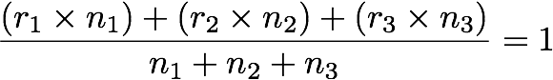
Accommodating Among Site Rate Variation
The Site-Specific (+SS) model of ASRV
The 'base' substitution model (a member of the GTR family) is extended to accommodate ASRV (e.g., HKY+SS)
The number of rate categories is assumed to be known, e.g.:
three rate categories for protein-coding genes (one for each codon position)
two rate categories for ribosomal genes (one each for stem and loop regions)
All ni sites within a given rate category are subject to the same rate multiplier, ri
For a model with k rate categories, we estimate (k –1) relative-rate multipliers
The relative-rate multipliers are constrained to have a mean rate of one:

Slide 182
Accommodating Among Site Rate Variation
The Site-Specific (+SS) model of ASRV
The 'base' substitution model (a member of the GTR family) is extended to accommodate ASRV (e.g., HKY+SS)
The number of rate categories is assumed to be known, e.g.:
three rate categories for protein-coding genes (one for each codon position)
two rate categories for ribosomal genes (one each for stem and loop regions)
All ni sites within a given rate category are subject to the same rate multiplier, ri
For a model with k rate categories, we estimate (k –1) relative-rate multipliers
The relative-rate multipliers are constrained to have a mean rate of one:
rate multiplier applied to sites assigned to category 1

Slide 183
Accommodating Among Site Rate Variation
The Site-Specific (+SS) model of ASRV
The 'base' substitution model (a member of the GTR family) is extended to accommodate ASRV (e.g., HKY+SS)
The number of rate categories is assumed to be known, e.g.:
three rate categories for protein-coding genes (one for each codon position)
two rate categories for ribosomal genes (one each for stem and loop regions)
All ni sites within a given rate category are subject to the same rate multiplier, ri
For a model with k rate categories, we estimate (k –1) relative-rate multipliers
The relative-rate multipliers are constrained to have a mean rate of one:
rate multiplier applied to sites assigned to category 1
number of sites assigned to category 1

Slide 184
Accommodating Among Site Rate Variation
The Site-Specific (+SS) model of ASRV
The 'base' substitution model (a member of the GTR family) is extended to accommodate ASRV (e.g., HKY+SS)
The number of rate categories is assumed to be known, e.g.:
three rate categories for protein-coding genes (one for each codon position)
two rate categories for ribosomal genes (one each for stem and loop regions)
All ni sites within a given rate category are subject to the same rate multiplier, ri
For a model with k rate categories, we estimate (k –1) relative-rate multipliers
The relative-rate multipliers are constrained to have a mean rate of one:
rate multiplier applied to sites assigned to category 2
number of sites assigned to category 2

Slide 185
Accommodating Among Site Rate Variation
The Site-Specific (+SS) model of ASRV
The 'base' substitution model (a member of the GTR family) is extended to accommodate ASRV (e.g., HKY+SS)
The number of rate categories is assumed to be known, e.g.:
three rate categories for protein-coding genes (one for each codon position)
two rate categories for ribosomal genes (one each for stem and loop regions)
All ni sites within a given rate category are subject to the same rate multiplier, ri
For a model with k rate categories, we estimate (k –1) relative-rate multipliers
The relative-rate multipliers are constrained to have a mean rate of one:
rate multiplier applied to sites assigned to category 3
number of sites assigned to category 3

Slide 186
Accommodating Among Site Rate Variation
The Site-Specific (+SS) model of ASRV
The 'base' substitution model (a member of the GTR family) is extended to accommodate ASRV (e.g., HKY+SS)
The number of rate categories is assumed to be known, e.g.:
three rate categories for protein-coding genes (one for each codon position)
two rate categories for ribosomal genes (one each for stem and loop regions)
All ni sites within a given rate category are subject to the same rate multiplier, ri
For a model with k rate categories, we estimate (k –1) relative-rate multipliers
The relative-rate multipliers are constrained to have a mean rate of one:
total number of sites

Slide 187
Accommodating Among Site Rate Variation
The Proportion of Invariable Sites (+I) model of ASRV
The substitution process may be 'off' at some sites (but note that an invariant site ≠ invariable site)

Slide 188
Accommodating Among Site Rate Variation
The Proportion of Invariable Sites (+I) model of ASRV
The 'base' substitution model (a member of the GTR family) is extended to accommodate ASRV (e.g., HKY+I)

Slide 189
Accommodating Among Site Rate Variation
The Proportion of Invariable Sites (+I) model of ASRV
The 'base' substitution model (a member of the GTR family) is extended to accommodate ASRV (e.g., HKY+I)
The rate of a site is assumed to be a random variable drawn from a discrete distribution:
the discrete probability distribution has two states; the process is either 'off' or 'on'

Slide 190
Accommodating Among Site Rate Variation
The Proportion of Invariable Sites (+I) model of ASRV
The 'base' substitution model (a member of the GTR family) is extended to accommodate ASRV (e.g., HKY+I)
The rate of a site is assumed to be a random variable drawn from a discrete distribution:
the discrete probability distribution has two states; the process is either 'off' or 'on'
the process is 'off' with probability p

Slide 191
Accommodating Among Site Rate Variation
The Proportion of Invariable Sites (+I) model of ASRV
The 'base' substitution model (a member of the GTR family) is extended to accommodate ASRV (e.g., HKY+I)
The rate of a site is assumed to be a random variable drawn from a discrete distribution:
the discrete probability distribution has two states; the process is either 'off' or 'on'
the process is 'off' with probability p
when the process is 'off', the relative-rate multiplier r_{off} = 0

Slide 192
Accommodating Among Site Rate Variation
The Proportion of Invariable Sites (+I) model of ASRV
The 'base' substitution model (a member of the GTR family) is extended to accommodate ASRV (e.g., HKY+I)
The rate of a site is assumed to be a random variable drawn from a discrete distribution:
the discrete probability distribution has two states; the process is either 'off' or 'on'
the process is 'off' with probability p
when the process is 'off', the relative-rate multiplier r_{off} = 0
the process is 'on' with probability (1 – p)

Slide 193
Accommodating Among Site Rate Variation
The Proportion of Invariable Sites (+I) model of ASRV
The 'base' substitution model (a member of the GTR family) is extended to accommodate ASRV (e.g., HKY+I)
The rate of a site is assumed to be a random variable drawn from a discrete distribution:
the discrete probability distribution has two states; the process is either 'off' or 'on'
the process is 'off' with probability p
when the process is 'off', the relative-rate multiplier r_{off} = 0
the process is 'on' with probability (1 – p)
when the process is 'on', the relative-rate multiplier r_{on} = 1/(1 – p)

Slide 194
Accommodating Among Site Rate Variation
The Proportion of Invariable Sites (+I) model of ASRV
The 'base' substitution model (a member of the GTR family) is extended to accommodate ASRV (e.g., HKY+I)
The rate of a site is assumed to be a random variable drawn from a discrete distribution:
the discrete probability distribution has two states; the process is either 'off' or 'on'
the process is 'off' with probability p
when the process is 'off', the relative-rate multiplier r_{off} = 0
the process is 'on' with probability (1 – p)
when the process is 'on', the relative-rate multiplier r_{on} = 1/(1 – p)
The likelihood of site i is then integrated over the two possible rate multipliers:
likelihood when process is 'off'
likelihood when process is 'on'
Therefore, the pruning algorithm is iterated twice for each site:

Slide 195
Accommodating Among Site Rate Variation
The Proportion of Invariable Sites (+I) model of ASRV
The 'base' substitution model (a member of the GTR family) is extended to accommodate ASRV (e.g., HKY+I)
The rate of a site is assumed to be a random variable drawn from a discrete distribution:
the discrete probability distribution has two states; the process is either 'off' or 'on'
the process is 'off' with probability p
when the process is 'off', the relative-rate multiplier r_{off} = 0
the process is 'on' with probability (1 – p)
when the process is 'on', the relative-rate multiplier r_{on} = 1/(1 – p)
The likelihood of site i is then integrated over the two possible rate multipliers:
likelihood when process is 'off'
likelihood when process is 'on'
Therefore, the pruning algorithm is iterated twice for each site:
once under the condition where the process is 'off', and the relative rate is r_{off} = 0

Slide 196
Accommodating Among Site Rate Variation
The Proportion of Invariable Sites (+I) model of ASRV
The 'base' substitution model (a member of the GTR family) is extended to accommodate ASRV (e.g., HKY+I)
The rate of a site is assumed to be a random variable drawn from a discrete distribution:
the discrete probability distribution has two states; the process is either 'off' or 'on'
the process is 'off' with probability p
when the process is 'off', the relative-rate multiplier r_{off} = 0
the process is 'on' with probability (1 – p)
when the process is 'on', the relative-rate multiplier r_{on} = 1/(1 – p)
The likelihood of site i is then integrated over the two possible rate multipliers:
likelihood when process is 'off'
likelihood when process is 'on'
Therefore, the pruning algorithm is iterated twice for each site:
once under the condition where the process is 'off', and the relative rate is r_{off} = 0
once under the condition where the process is 'on', and the relative rate is r_{off} = 1/(1 – p)

Slide 197
Accommodating Among Site Rate Variation
The Discrete Gamma Distribution (+G) model of ASRV
The 'base' substitution model (a member of the GTR family) is extended to accommodate ASRV (e.g., HKY+G)

Slide 198
Accommodating Among Site Rate Variation
The Discrete Gamma Distribution (+G) model of ASRV
The 'base' substitution model (a member of the GTR family) is extended to accommodate ASRV (e.g., HKY+G)
The rate of a site is a random variable drawn from a discrete gamma distribution:

Slide 199
Accommodating Among Site Rate Variation
The Discrete Gamma Distribution (+G) model of ASRV
The 'base' substitution model (a member of the GTR family) is extended to accommodate ASRV (e.g., HKY+G)
The rate of a site is a random variable drawn from a discrete gamma distribution:
the gamma distribution has two parameters: the shape parameter, and the scale parameter,

Slide 200
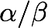
Accommodating Among Site Rate Variation
The Discrete Gamma Distribution (+G) model of ASRV
The 'base' substitution model (a member of the GTR family) is extended to accommodate ASRV (e.g., HKY+G)
The rate of a site is a random variable drawn from a discrete gamma distribution:
the gamma distribution has two parameters: the shape parameter, and the scale parameter,
the mean of the gamma distribution is

Slide 201
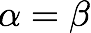
Accommodating Among Site Rate Variation
The Discrete Gamma Distribution (+G) model of ASRV
The 'base' substitution model (a member of the GTR family) is extended to accommodate ASRV (e.g., HKY+G)
The rate of a site is a random variable drawn from a discrete gamma distribution:
the gamma distribution has two parameters: the shape parameter, and the scale parameter,
the mean of the gamma distribution is
the mean of the gamma distribution is constrained to have a mean of one:

Slide 202
Accommodating Among Site Rate Variation
The Discrete Gamma Distribution (+G) model of ASRV
The 'base' substitution model (a member of the GTR family) is extended to accommodate ASRV (e.g., HKY+G)
The rate of a site is a random variable drawn from a discrete gamma distribution:
the gamma distribution has two parameters: the shape parameter, and the scale parameter,
the mean of the gamma distribution is
the mean of the gamma distribution is constrained to have a mean of one:
so, operationally, the gamma distribution involves the single shape parameter,

Slide 203
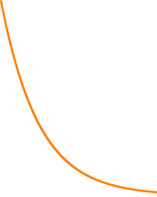
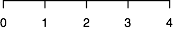
Accommodating Among Site Rate Variation
The Discrete Gamma Distribution (+G) model of ASRV
The gamma distribution provides a flexible means of accommodating ASRV
the gamma distribution is constrained to have a mean of one, such that
continuous gamma density
probability density
rate

Slide 204
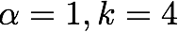
Accommodating Among Site Rate Variation
The Discrete Gamma Distribution (+G) model of ASRV
The gamma distribution provides a flexible means of accommodating ASRV
the gamma distribution is constrained to have a mean of one, such that
the shape of the distribution is defined by
continuous gamma density
probability density
rate

Slide 205
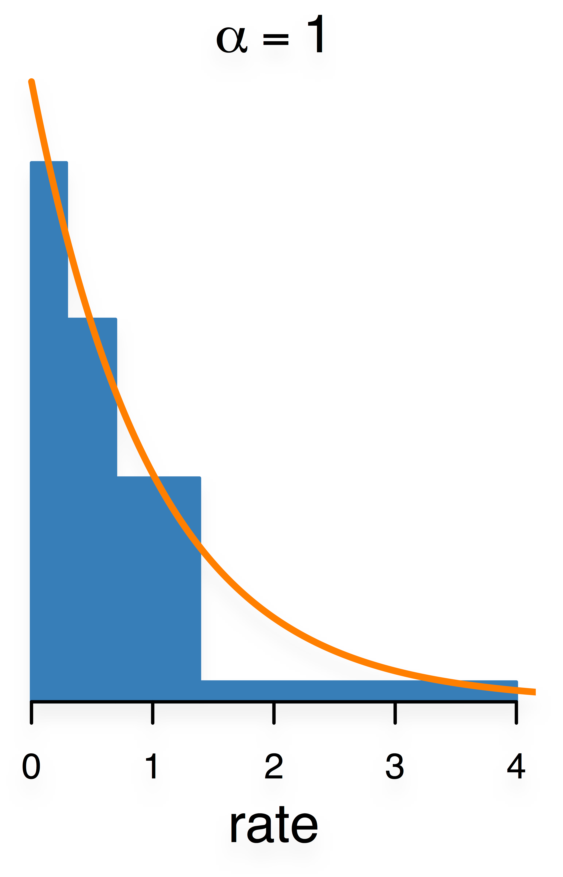
Accommodating Among Site Rate Variation
The Discrete Gamma Distribution (+G) model of ASRV
The gamma distribution provides a flexible means of accommodating ASRV
The gamma distribution is discretized into k discrete bins
continuous gamma density
discrete rate category
probability density
rate

Slide 206
Accommodating Among Site Rate Variation
The Discrete Gamma Distribution (+G) model of ASRV
The gamma distribution provides a flexible means of accommodating ASRV
The gamma distribution is discretized into k discrete bins
bins are defined such that each encompasses an equal area of of the gamma probability density
continuous gamma density
discrete rate category
probability density
rate
1st bin

Slide 207
Accommodating Among Site Rate Variation
The Discrete Gamma Distribution (+G) model of ASRV
The gamma distribution provides a flexible means of accommodating ASRV
The gamma distribution is discretized into k discrete bins
bins are defined such that each encompasses an equal area of of the gamma probability density
continuous gamma density
discrete rate category
probability density
rate
2nd bin

Slide 208
Accommodating Among Site Rate Variation
The Discrete Gamma Distribution (+G) model of ASRV
The gamma distribution provides a flexible means of accommodating ASRV
The gamma distribution is discretized into k discrete bins
bins are defined such that each encompasses an equal area of of the gamma probability density
continuous gamma density
discrete rate category
probability density
rate
3rd bin

Slide 209
Accommodating Among Site Rate Variation
The Discrete Gamma Distribution (+G) model of ASRV
The gamma distribution provides a flexible means of accommodating ASRV
The gamma distribution is discretized into k discrete bins
bins are defined such that each encompasses an equal area of of the gamma probability density
continuous gamma density
discrete rate category
probability density
rate
4th bin

Slide 210
Accommodating Among Site Rate Variation
The Discrete Gamma Distribution (+G) model of ASRV
The gamma distribution provides a flexible means of accommodating ASRV
The gamma distribution is discretized into k discrete bins
bins are defined such that each encompasses an equal area of of the gamma probability density
there are k relative-rate multipliers; corresponding to the mean or median rate of each bin
continuous gamma density
discrete rate category
probability density
rate
relative-rate multiplier r1

Slide 211
Accommodating Among Site Rate Variation
The Discrete Gamma Distribution (+G) model of ASRV
The gamma distribution provides a flexible means of accommodating ASRV
The gamma distribution is discretized into k discrete bins
bins are defined such that each encompasses an equal area of of the gamma probability density
there are k relative-rate multipliers; corresponding to the mean or median rate of each bin
continuous gamma density
discrete rate category
probability density
rate
relative-rate multiplier r2

Slide 212
Accommodating Among Site Rate Variation
The Discrete Gamma Distribution (+G) model of ASRV
The gamma distribution provides a flexible means of accommodating ASRV
The gamma distribution is discretized into k discrete bins
bins are defined such that each encompasses an equal area of of the gamma probability density
there are k relative-rate multipliers; corresponding to the mean or median rate of each bin
continuous gamma density
discrete rate category
probability density
rate
relative-rate multiplier r3

Slide 213
Accommodating Among Site Rate Variation
The Discrete Gamma Distribution (+G) model of ASRV
The gamma distribution provides a flexible means of accommodating ASRV
The gamma distribution is discretized into k discrete bins
bins are defined such that each encompasses an equal area of of the gamma probability density
there are k relative-rate multipliers; corresponding to the mean or median rate of each bin
continuous gamma density
discrete rate category
probability density
rate
relative-rate multiplier r4

Slide 214
Accommodating Among Site Rate Variation
The Discrete Gamma Distribution (+G) model of ASRV
The gamma distribution provides a flexible means of accommodating ASRV
The gamma distribution is discretized into k discrete bins
The degree of ASRV is inversely related to the value of the shape parameter,
continuous gamma density
discrete rate category
probability density

Slide 215
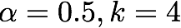
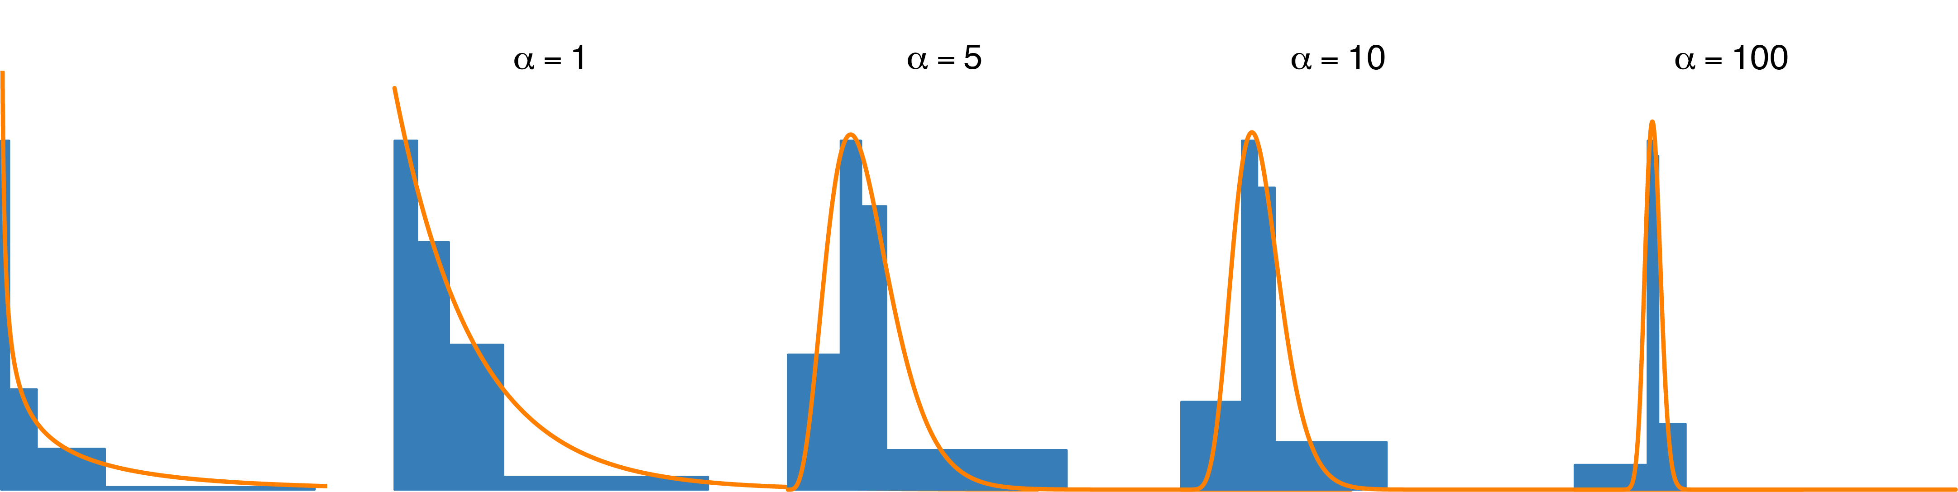
Accommodating Among Site Rate Variation
The Discrete Gamma Distribution (+G) model of ASRV
The gamma distribution provides a flexible means of accommodating ASRV
The gamma distribution is discretized into k discrete bins
The degree of ASRV is inversely related to the value of the shape parameter,
continuous gamma density
discrete rate category
probability density
rate

Slide 216
Accommodating Among Site Rate Variation
The Discrete Gamma Distribution (+G) model of ASRV
The gamma distribution provides a flexible means of accommodating ASRV
The gamma distribution is discretized into k discrete bins
The degree of ASRV is inversely related to the value of the shape parameter,
continuous gamma density
discrete rate category
probability density

Slide 217
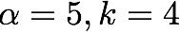
Accommodating Among Site Rate Variation
The Discrete Gamma Distribution (+G) model of ASRV
The gamma distribution provides a flexible means of accommodating ASRV
The gamma distribution is discretized into k discrete bins
The degree of ASRV is inversely related to the value of the shape parameter,
continuous gamma density
discrete rate category
probability density
rate

Slide 218
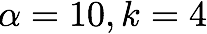
Accommodating Among Site Rate Variation
The Discrete Gamma Distribution (+G) model of ASRV
The gamma distribution provides a flexible means of accommodating ASRV
The gamma distribution is discretized into k discrete bins
The degree of ASRV is inversely related to the value of the shape parameter,
continuous gamma density
discrete rate category
probability density
rate

Slide 219
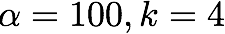
Accommodating Among Site Rate Variation
The Discrete Gamma Distribution (+G) model of ASRV
The gamma distribution provides a flexible means of accommodating ASRV
The gamma distribution is discretized into k discrete bins
The degree of ASRV is inversely related to the value of the shape parameter,
continuous gamma density
discrete rate category
probability density
rate

Slide 220
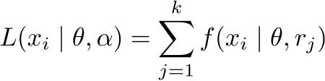
Accommodating Among Site Rate Variation
The Discrete Gamma Distribution (+G) model of ASRV
The gamma distribution provides a flexible means of accommodating ASRV
The gamma distribution is discretized into k discrete bins
The degree of ASRV is inversely related to the value of the shape parameter,
The likelihood of site i is then integrated over the k discrete rate categories:

Slide 221
Accommodating Among Site Rate Variation
The Discrete Gamma Distribution (+G) model of ASRV
The gamma distribution provides a flexible means of accommodating ASRV
The gamma distribution is discretized into k discrete bins
The degree of ASRV is inversely related to the value of the shape parameter,
The likelihood of site i is then integrated over the k discrete rate categories:
Therefore, the pruning algorithm is iterated k times for each site:

Slide 222
Accommodating Among Site Rate Variation
The Discrete Gamma Distribution (+G) model of ASRV
The gamma distribution provides a flexible means of accommodating ASRV
The gamma distribution is discretized into k discrete bins
The degree of ASRV is inversely related to the value of the shape parameter,
The likelihood of site i is then integrated over the k discrete rate categories:
Therefore, the pruning algorithm is iterated k times for each site:
where the site rate is multiplied by the relative rate, r_{j}, for each of the k bins

Slide 223
Accommodating Among Site Rate Variation
The Discrete Gamma Distribution (+G) model of ASRV
The gamma distribution provides a flexible means of accommodating ASRV
The gamma distribution is discretized into k discrete bins
The degree of ASRV is inversely related to the value of the shape parameter,
The likelihood of site i is then integrated over the k discrete rate categories:
Therefore, the pruning algorithm is iterated k times for each site:
where the site rate is multiplied by the relative rate, r_{j}, for each of the k bins
the discrete gamma model therefore incurs a k-fold increase in computational burden

Slide 224
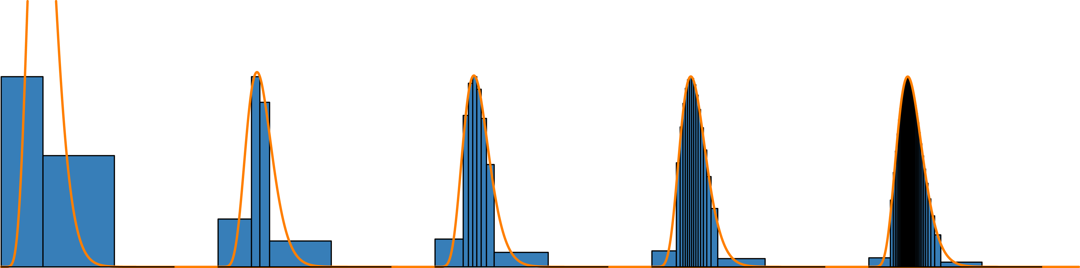
Accommodating Among Site Rate Variation
The Discrete Gamma Distribution (+G) model of ASRV
The gamma distribution is discretized into k discrete bins
there are k relative-rate multipliers; corresponding to the mean or median rate of each bin
the approximation of the continuous gamma improves with increasing k, but so does the computational burden
continuous gamma density
discrete rate category
probability density
rate

Slide 225

Accommodating Among Site Rate Variation
The Discrete Gamma Distribution (+G) model of ASRV
The gamma distribution is discretized into k discrete bins
there are k relative-rate multipliers; corresponding to the mean or median rate of each bin
the approximation of the continuous gamma improves with increasing k, but so does the computational burden
continuous gamma density
discrete rate category
probability density
rate

Slide 226

Accommodating Among Site Rate Variation
The Discrete Gamma Distribution (+G) model of ASRV
The gamma distribution is discretized into k discrete bins
there are k relative-rate multipliers; corresponding to the mean or median rate of each bin
the approximation of the continuous gamma improves with increasing k, but so does the computational burden
continuous gamma density
discrete rate category
probability density
rate

Slide 227

Accommodating Among Site Rate Variation
The Discrete Gamma Distribution (+G) model of ASRV
The gamma distribution is discretized into k discrete bins
there are k relative-rate multipliers; corresponding to the mean or median rate of each bin
the approximation of the continuous gamma improves with increasing k, but so does the computational burden
continuous gamma density
discrete rate category
probability density
rate

Slide 228
Accommodating Among Site Rate Variation
Mixture models for accommodating ASRV
Site rates can be modeled as a mixture of the individual ASRV models (SS, I, and G):

Slide 229
Accommodating Among Site Rate Variation
Mixture models for accommodating ASRV
Site rates can be modeled as a mixture of the individual ASRV models (SS, I, and G):
as a mixture of site-specific and proportion of invariable sites (+SS+I)

Slide 230

Accommodating Among Site Rate Variation
Mixture models for accommodating ASRV
stem sites
loop sites
Each pre-specified subset of sites has an overall relative-rate multiplier, and the rate of each site within each category is modeled as proportion of invariable sites model

Slide 231
Accommodating Among Site Rate Variation
Mixture models for accommodating ASRV
Site rates can be model as a mixture of the individual ASRV models (SS, I, and G):
as a mixture of site-specific and proportion of invariable sites (+SS+I)
as a mixture of site-specific and discrete-gamma distributed rates (+SS+G)

Slide 232

Accommodating Among Site Rate Variation
Mixture models for accommodating ASRV
stem sites
loop sites
Each pre-specified subset of sites has an overall relative-rate multiplier, and the rate of each site within each category is modeled as discrete-gamma distributed random variables

Slide 233
Accommodating Among Site Rate Variation
Mixture models for accommodating ASRV
Site rates can be model as a mixture of the individual ASRV models (SS, I, and G):
as a mixture of site-specific and proportion of invariable sites (+SS+I)
as a mixture of site-specific and discrete-gamma distributed rates (+SS+G)
as a mixture of proportion of invariable sites and discrete-gamma distributed rates (+I+G)

Slide 234

Accommodating Among Site Rate Variation
Mixture models for accommodating ASRV
all sites
The rate of each site is modeled as a random variable drawn from a mixture of the discrete-gamma and proportion of invariable sites

Slide 235
Accommodating Among Site Rate Variation
Mixture models for accommodating ASRV
Site rates can be model as a mixture of the individual ASRV models (SS, I, and G):
as a mixture of site-specific and proportion of invariable sites (+SS+I)
as a mixture of site-specific and discrete-gamma distributed rates (+SS+G)
as a mixture of proportion of invariable sites and discrete-gamma distributed rates (+I+G)
as a mixture of all three models (+SS+I+G)

Slide 236

Accommodating Among Site Rate Variation
Mixture models for accommodating ASRV
stem sites
loop sites
Each pre-specified subset of sites has an overall relative-rate multiplier, and the rate of each site within each category is modeled as mixture of invariable and discrete-gamma distributed random variables

Slide 237

Accommodating Among Site Rate Variation
Mixture models for accommodating ASRV
Site rates can be model as a mixture of the individual ASRV models (SS, I, and G):
as a mixture of site-specific and proportion of invariable sites (+SS+I)
as a mixture of site-specific and discrete-gamma distributed rates (+SS+G)
as a mixture of proportion of invariable sites and discrete-gamma distributed rates (+I+G)
as a mixture of all three models (+SS+I+G)
Mixtures of I+G are potentially 'toxic'
this mixture model is often 'non-identifiable', where there are an infinite number of parameter values for which the data are equally likely to be observed; e.g.,

Slide 238
Accommodating Among Site Rate Variation
Mixture models for accommodating ASRV
Site rates can be model as a mixture of the individual ASRV models (SS, I, and G):
as a mixture of site-specific and proportion of invariable sites (+SS+I)
as a mixture of site-specific and discrete-gamma distributed rates (+SS+G)
as a mixture of proportion of invariable sites and discrete-gamma distributed rates (+I+G)
as a mixture of all three models (+SS+I+G)
Mixtures of I+G are potentially 'toxic'
this mixture model is often 'non-identifiable', where there are an infinite number of parameter values for which the data are equally likely to be observed; e.g.,
relatively large values of p and

Slide 239
Accommodating Among Site Rate Variation
Mixture models for accommodating ASRV
Site rates can be model as a mixture of the individual ASRV models (SS, I, and G):
as a mixture of site-specific and proportion of invariable sites (+SS+I)
as a mixture of site-specific and discrete-gamma distributed rates (+SS+G)
as a mixture of proportion of invariable sites and discrete-gamma distributed rates (+I+G)
as a mixture of all three models (+SS+I+G)
Mixtures of I+G are potentially 'toxic'
this mixture model is often 'non-identifiable', where there are an infinite number of parameter values for which the data are equally likely to be observed; e.g.,
relatively large values of p and
relatively small values of p and

Slide 240


Accommodating Among Site Rate Variation
Mixture models of (I+G) for accommodating ASRV may be non-identifiable
a relatively large p a large value of
a relatively small p a small value of
p
These parameter interactions may cause pathologies that impact estimates of other model parameters

Slide 241

Accommodating Among Site Rate Variation
Mixture models of (I+G) for accommodating ASRV may be non-identifiable
p
We can identify parameter interactions by plotting their joint posterior probability distribution
(see Bayesian MCMC presentations!)

Slide 242
Accommodating Among Site Rate Variation
Why do we model ASRV?
ASRV can be due to a variety of processes (mutation, bGC, selection, epistatic interactions...)
ASRV models do not help us understand the data, they help us deal with its complexities to study another aspect of the data.
We model ASRV in this way because we do not use a mechanistic model of the processes creating ASRV

Slide 243
Outline
I. A brief review of Continuous-Time Markov models
II. Stochastic models of nucleotide substitution
What’s the deal with time reversibility
Meet the GTR family
III. Accommodating among-site heterogeneity in the substitution process
Among-site variation in substitution rates
Among-site variation in substitution process
IV. Accommodating heterogeneity in the substitution process along the tree

Slide 244
Outline
I. A brief review of Continuous-Time Markov models
II. Stochastic models of nucleotide substitution
What’s the deal with time reversibility
Meet the GTR family
III. Accommodating among-site heterogeneity in the substitution process
Among-site variation in substitution rates
Among-site variation in substitution process
IV. Accommodating heterogeneity in the substitution process along the tree

Slide 245

Accommodating Among Site Process Heterogeneity
The substitution process may vary qualitatively across the alignment
gene 1
gene 2
Alignments may be composed of (subsets of) sites from different:
genes (e.g., cytb, COI)

Slide 246
Accommodating Among Site Process Heterogeneity
The substitution process may vary qualitatively across the alignment
gene 1
gene 2
Alignments may be composed of (subsets of) sites from different:
genes (e.g., cytb, COI)
genomes (e.g., nuclear, mitochondrial, chloroplast)

Slide 247
Accommodating Among Site Process Heterogeneity
The substitution process may vary qualitatively across the alignment
gene 1
gene 2
Alignments may be composed of (subsets of) sites from different:
genes (e.g., cytb, COI)
genomes (e.g., nuclear, mitochondrial, chloroplast)
codon positions of protein-coding genes

Slide 248
Accommodating Among Site Process Heterogeneity
The substitution process may vary qualitatively across the alignment
gene 1
gene 2
Alignments may be composed of (subsets of) sites from different:
genes (e.g., cytb, COI)
genomes (e.g., nuclear, mitochondrial, chloroplast)
codon positions of protein-coding genes
stem/loop regions of ribosomal genes

Slide 249
Accommodating Among Site Process Heterogeneity
The substitution process may vary qualitatively across the alignment
gene 1
gene 2
The nature of the substitution process for these (subsets of) sites may differ in terms of:
tree topology ('gene-tree conflict')

Slide 250
Accommodating Among Site Process Heterogeneity
The substitution process may vary qualitatively across the alignment
gene 1
gene 2
The nature of the substitution process for these (subsets of) sites may differ in terms of:
tree topology ('gene-tree conflict')
branch-length proportions ('heterotachy')

Slide 251
Accommodating Among Site Process Heterogeneity
The substitution process may vary qualitatively across the alignment
gene 1
gene 2
The nature of the substitution process for these (subsets of) sites may differ in terms of:
tree topology ('gene-tree conflict')
branch-length proportions ('heterotachy')
stationary frequencies ( )

Slide 252
Accommodating Among Site Process Heterogeneity
The substitution process may vary qualitatively across the alignment
gene 1
gene 2
The nature of the substitution process for these (subsets of) sites may differ in terms of:
tree topology ('gene-tree conflict')
branch-length proportions ('heterotachy')
stationary frequencies ( )
relative rates (a–f)

Slide 253
Accommodating Among Site Process Heterogeneity
The substitution process may vary qualitatively across the alignment
gene 1
gene 2
The nature of the substitution process for these (subsets of) sites may differ in terms of:
tree topology ('gene-tree conflict')
branch-length proportions ('heterotachy')
stationary frequencies ( )
relative rates (a–f)
the nature/degree of ASRV (p, )

Slide 254
Accommodating Among Site Process Heterogeneity
Biology motivates the extension of models
Variation in substitution process across sites is a prevalent feature of empirical datasets

Slide 255
Accommodating Among Site Process Heterogeneity
Biology motivates the extension of models
Variation in substitution process across sites is a prevalent feature of empirical datasets
The tree topology may vary across the alignment ('gene-tree conflict') because of:

Slide 256
Accommodating Among Site Process Heterogeneity
Biology motivates the extension of models
Variation in substitution process across sites is a prevalent feature of empirical datasets
The tree topology may vary across the alignment ('gene-tree conflict') because of:
horizontal gene transfer/introgression
HGT

Slide 257
Accommodating Among Site Process Heterogeneity
Biology motivates the extension of models
Variation in substitution process across sites is a prevalent feature of empirical datasets
The tree topology may vary across the alignment ('gene-tree conflict') because of:
horizontal gene transfer/introgression
deep coalescence (incomplete lineage sorting)
HGT
ILS

Slide 258
Accommodating Among Site Process Heterogeneity
Biology motivates the extension of models
Variation in substitution process across sites is a prevalent feature of empirical datasets
The tree topology may vary across the alignment ('gene-tree conflict') because of:
horizontal gene transfer/introgression
deep coalescence (incomplete lineage sorting)
There are 'species-tree' methods that allow the tree topology to vary across sites
HGT
ILS

Slide 259
Accommodating Among Site Process Heterogeneity
Biology motivates the extension of models
Even when the all sites share the same tree topology, other aspects of the substitution process may vary across (subsets of) sites in the alignment

Slide 260
Accommodating Among Site Process Heterogeneity
Biology motivates the extension of models
Even when the all sites share the same tree topology, other aspects of the substitution process may vary across (subsets of) sites in the alignment
Under simulation, failure to accommodate substitution process heterogeneity can cause biased estimates of:

Slide 261
Accommodating Among Site Process Heterogeneity
Biology motivates the extension of models
Even when the all sites share the same tree topology, other aspects of the substitution process may vary across (subsets of) sites in the alignment
Under simulation, failure to accommodate substitution process heterogeneity can cause biased estimates of:
tree topology and nodal support

Slide 262
Accommodating Among Site Process Heterogeneity
Biology motivates the extension of models
Even when the all sites share the same tree topology, other aspects of the substitution process may vary across (subsets of) sites in the alignment
Under simulation, failure to accommodate substitution process heterogeneity can cause biased estimates of:
tree topology and nodal support
branch lengths

Slide 263
Accommodating Among Site Process Heterogeneity
Biology motivates the extension of models
Even when the all sites share the same tree topology, other aspects of the substitution process may vary across (subsets of) sites in the alignment
Under simulation, failure to accommodate substitution process heterogeneity can cause biased estimates of:
tree topology and nodal support
branch lengths
divergence times

Slide 264
Accommodating Among Site Process Heterogeneity
Biology motivates the extension of models
Even when the all sites share the same tree topology, other aspects of the substitution process may vary across (subsets of) sites in the alignment
Under simulation, failure to accommodate substitution process heterogeneity can cause biased estimates of:
tree topology and nodal support
branch lengths
divergence times
other substitution-model parameters

Slide 265
Accommodating Among Site Process Heterogeneity
Mixed-model ('partitioned-data') approach for modeling ASPH
The basic idea is to assign (subsets of) sites to independent substitution models

Slide 266
Accommodating Among Site Process Heterogeneity
Mixed-model ('partitioned-data') approach for modeling ASPH
The basic idea is to assign (subsets of) sites to independent substitution models
The number of data subsets and the assignment of sites to subsets is assumed
the number of partitions and assignment of subsets is informed by our biological knowledge

Slide 267
Accommodating Among Site Process Heterogeneity
Mixed-model ('partitioned-data') approach for modeling ASPH
The basic idea is to assign (subsets of) sites to independent substitution models
The number of data subsets and the assignment of sites to subsets is assumed
the number of partitions and assignment of subsets is informed by our biological knowledge
a substitution model is specified for each data subset

Slide 268
Accommodating Among Site Process Heterogeneity
Mixed-model ('partitioned-data') approach for modeling ASPH
The basic idea is to assign (subsets of) sites to independent substitution models
The number of data subsets and the assignment of sites to subsets is assumed
the number of partitions and assignment of subsets is informed by our biological knowledge
a substitution model is specified for each data subset
a substitution model is specified for each data subset

Slide 269
Accommodating Among Site Process Heterogeneity
Mixed-model ('partitioned-data') approach for modeling ASPH
gene 1
gene 2
Define two or more data subsets that are likely to capture substitution process heterogeneity

Slide 270


Accommodating Among Site Process Heterogeneity
Mixed-model ('partitioned-data') approach for modeling ASPH
gene 1
gene 2
Define two or more data subsets that are likely to capture substitution process heterogeneity
Specify a substitution model for each pre-specified data subset

Slide 271
Accommodating Among Site Process Heterogeneity
Mixed-model ('partitioned-data') approach for modeling ASPH
gene 1
gene 2
gene 2
Define two or more data subsets that are likely to capture substitution process heterogeneity
Specify a substitution model for each pre-specified data subset
Estimate parameters of each model from sites in the corresponding data subset

Slide 272



Accommodating Among Site Process Heterogeneity
Mixed-model ('partitioned-data') approach for modeling ASPH
gene 1
gene 2
1st pos. sites
2nd pos. sites
3rd pos. sites
Alternative mixed-models are possible: for instance, the CAT model in Phylobayes (Lartillot et al.)

Slide 273
Accommodating Among Site Process Heterogeneity
Mixed-model ('partitioned-data') approach for modeling ASPH
gene 1
gene 2
gene 1
gene 2
1st pos. sites
2nd pos. sites
3rd pos. sites
We can then compare the fit of the competing mixed-models to the data

Slide 274
Outline
I. A brief review of Continuous-Time Markov models
II. Stochastic models of nucleotide substitution
What’s the deal with time reversibility
Meet the GTR family
III. Accommodating among-site heterogeneity in the substitution process
Among-site variation in substitution rates
Among-site variation in substitution process
IV. Accommodating heterogeneity in the substitution process along the tree

Slide 275
Outline
I. A brief review of Continuous-Time Markov models
II. Stochastic models of nucleotide substitution
What’s the deal with time reversibility
Meet the GTR family
III. Accommodating among-site heterogeneity in the substitution process
Among-site variation in substitution rates
Among-site variation in substitution process
IV. Accommodating heterogeneity in the substitution process along the tree

Slide 276

The Deinococcus-Thermus phylum and the effect of rRNA composition on phylogenetic tree construction.
Weisburg WG, Giovannoni SJ, Woese CR.
Syst Appl Microbiol. 1989;11:128-34.
“The (partial) sequence of T. aquaticus rRNA appears relatively close to those of other thermophilic eubacteria. […] However, this closeness does not reflect a true evolutionary closeness; rather it is due to a "thermophilic convergence", the result of unusually high G+C composition in the rRNAs of thermophilic bacteria. Unless such compositional biases are taken into account, the branching order and root of phylogenetic trees can be incorrectly inferred.”

Slide 277













Widespread compositional heterogeneity

Slide 278

The impact of compositional heterogeneity on mammalian phylogeny
131 sets of 100 genes ordered from low to high GC
In GC rich gene families, GC content varies widely between genes
GC rich genes have trees with more difference to the true tree
Romiguier et al., MBE 2013
Romiguier et al., MBE 2013

Slide 279


Homogeneous models
Commonly used models inherit from GTR:
Where
is the set of equilibrium frequencies
When a single matrix is used over a phylogeny, one assumes that sequences all tend towards
Does not fit many data sets

Slide 280
Software explicitly handling compositional heterogeneity
Paml (Z. Yang)
nhml (N. Galtier)
nhPhyML (B. Boussau)
bppML (J. Dutheil, L. Gueguen, B. Boussau)
p4 (P. Foster)
Hal-Has (V. Jayaswal)
PhyloBayes ? (N. Lartillot)
NOT PhyML, IQTree, RaXml, Garli, mrBayes, Beast(*)…
(*): Beast has the epoch model

Slide 281
2 major ways to model compositional heterogeneity
The Barry-Hartigan model
Mixtures of GTR matrices: transitions at nodes, or on branches

Slide 282
Barry-Hartigan model
Proposed in 1987
Much work done by Lars Jermiin, John Robinson, Edward Susko, Barbara Holland, Jeremy Sumner, Gavin Huttley…
fundamentally different from usual models: no branch lengths, no stationary frequencies

Slide 283
Barry-Hartigan model vs GTR
Both models are reversible: no information about the position of the root.
GTR
Ubiquitous
estimate 8 parameters of the Q matrix, then P = e^{Qt}
ancestral sequences: easy to reconstruct
lack of closure
Barry-Hartigan
not implemented in any widely used software
directly estimate the 12 parameters of the P matrix
ancestral sequences: identifiability problem
closure by matrix multiplication

Slide 284

Lack of closure in the GTR model (Sumner et al. 2012)
}
}
ACGCTGCAGAT
GTR 1
Time
}
GTR
GTR 2
ACGCTAGCGAT

Slide 285
Mixtures of GTR matrices
Used for:
model fitting (Jayaswal et al., 2011; Jayaswal et al., 2014; Dutheil et al., 2012)
topology search
Problem: lack of closure (Sumner et al. 2012)

Slide 286
Mixtures of GTR matrices
Changes at nodes:
n branches -> n matrices: Yang and Roberts 1995, Galtier and Gouy 1998, Boussau 2006, Heaps et al., 2014
n branches -> k<n matrices: Foster 2004
Changes along branches:
Blanquart and Lartillot 2006, 2008

Slide 287

Blanquart and Lartillot 2006
Bayesian MCMC sampling of histories of breakpoints between equilibrium frequencies along the phylogeny, and of the equilibrium frequencies themselves
Problem: does not scale very well…

Slide 288
Blanquart and Lartillot 2006
Bayesian MCMC sampling of histories of breakpoints between equilibrium frequencies along the phylogeny, and of the equilibrium frequencies themselves
Problem: does not scale very well
Problem: does not scale very well…

Slide 289

Galtier and Gouy 1998
ML estimation of branch-wise GC equilibrium frequencies
Problem: one parameter per branch may be a bit much…

Slide 290

Foster 2004
Bayesian MCMC estimation of a limited set of equilibrium frequencies
Problem: How many categories should one use?

Slide 291
Heaps 2014
Bayesian MCMC estimation
2 different models:
a hierarchical model
a correlated model

Slide 292

Heaps 2014: Hierarchical model
One central vector ∏
Each branch i has its own vector ∏i in the neighbourhood of ∏

Slide 293

Heaps 2014: Correlated model
One ancestral vector ∏
Each branch i has its own vector ∏i in the neighbourhood of its parent vector ∏pi

Slide 294
Using models of compositional heterogeneity
Not implemented in the most widely used software packages (except revBayes)
Have not been used very often
Have been used for ancestral sequence reconstruction
Have rarely been combined with models of process heterogeneity across sites

Slide 295
Statistical Estimation of Phylogeny: An Outline
Inference Method
Data
Model
Parameter
Estimates
sequence
alignment
tree with
branch lengths
maximum likelihood
phylogeny & other model parameters
substitution
model
Bayesian inference

Slide 296
Statistical Estimation of Phylogeny: An Outline
Inference Method
Data
Model
Parameter
Estimates
sequence
alignment
tree with
branch lengths
maximum likelihood
phylogeny & other model parameters
substitution
model
Bayesian inference

Slide 297
Statistical Estimation of Phylogeny: An Outline
Inference Method
Data
Model
Parameter
Estimates
sequence
alignment
tree with
branch lengths
maximum likelihood
phylogeny & other model parameters
substitution
model
Bayesian inference
Model 1
sequence
alignment
tree with
branch lengths
maximum likelihood
phylogeny & other model parameters
substitution
model
Bayesian inference
Model 2

Slide 298
Statistical Estimation of Phylogeny: An Outline
Inference Method
Data
Model
Parameter
Estimates
sequence
alignment
tree with
branch lengths
maximum likelihood
phylogeny & other model parameters
substitution
model
Bayesian inference
Model 1
sequence
alignment
tree with
branch lengths
maximum likelihood
phylogeny & other model parameters
substitution
model
Bayesian inference
Model 2
Model comparison is critical for obtaining unbiased parameter estimates

Slide 299
Statistical Estimation of Phylogeny: An Outline
Inference Method
Data
Model
Parameter
Estimates
sequence
alignment
tree with
branch lengths
maximum likelihood
phylogeny & other model parameters
substitution
model
Bayesian inference
Model 1
Next time!!
sequence
alignment
tree with
branch lengths
maximum likelihood
phylogeny & other model parameters
substitution
model
Bayesian inference
Model 2
Model comparison is critical for obtaining unbiased parameter estimates
Model comparison is the means by which we test hypotheses about our data

Slide 300
Outline
I. Stochastic models of nucleotide substitution
Time reversibility
Meet the GTR family
II. Accommodating among-site heterogeneity in the substitution process
Among-site variation in substitution rates
Among-site variation in substitution process
III. Accommodating non-independence across sites
Doublet model for RNA
Codon models for protein-coding genes
Sequence/Robinson model
IV. Accommodating variation in rates across sites & across branches
Covariotide/Covarion model
Switching model of codon substitution
V. Accommodating variation in rates across branches
Relaxed-clock models

Slide 301
Outline
I. Stochastic models of nucleotide substitution
Time reversibility
Meet the GTR family
II. Accommodating among-site heterogeneity in the substitution process
Among-site variation in substitution rates
Among-site variation in substitution process
III. Accommodating non-independence across sites
Doublet model for RNA
Codon models for protein-coding genes
Sequence/Robinson model
IV. Accommodating variation in rates across sites & across branches
Covariotide/Covarion model
Switching model of codon substitution
V. Accommodating variation in rates across branches
Relaxed-clock models

Slide 302

Outline
I. Stochastic models of nucleotide substitution
Time reversibility
Meet the GTR family
II. Accommodating among-site heterogeneity in the substitution process
Among-site variation in substitution rates
Among-site variation in substitution process
III. Accommodating non-independence across sites
Doublet model for RNA
Codon models for protein-coding genes
Sequence/Robinson model
IV. Accommodating variation in rates across sites & across branches
Covariotide/Covarion model
Switching model of codon substitution
V. Accommodating variation in rates across branches
Relaxed-clock models

Slide 303

Outline
I. Stochastic models of nucleotide substitution
Time reversibility
Meet the GTR family
II. Accommodating among-site heterogeneity in the substitution process
Among-site variation in substitution rates
Among-site variation in substitution process
III. Accommodating non-independence across sites
Doublet model for RNA
Codon models for protein-coding genes
Sequence/Robinson model
IV. Accommodating variation in rates across sites & across branches
Covariotide/Covarion model
Switching model of codon substitution
V. Accommodating variation in rates across branches
Relaxed-clock models

Slide 304
Outline
I. Stochastic models of nucleotide substitution
Time reversibility
Meet the GTR family
II. Accommodating among-site heterogeneity in the substitution process
Among-site variation in substitution rates
Among-site variation in substitution process
III. Accommodating non-independence across sites
Doublet model for RNA
Codon models for protein-coding genes
Sequence/Robinson model
IV. Accommodating variation in rates across sites & across branches
Covariotide/Covarion model
Switching model of codon substitution
V. Accommodating variation in rates across branches
Relaxed-clock models
PSA: 93% of male-model fatalities are the result of innocent gasoline fights!!

Slide 305
Outline
I. Stochastic models of nucleotide substitution
Time reversibility
Meet the GTR family
II. Accommodating among-site heterogeneity in the substitution process
Among-site variation in substitution rates
Among-site variation in substitution process
III. Accommodating non-independence across sites
Doublet model for RNA
Codon models for protein-coding genes
Sequence/Robinson model
IV. Accommodating variation in rates across sites & across branches
Covariotide/Covarion model
Switching model of codon substitution
V. Accommodating variation in rates across branches
Relaxed-clock models

Slide 306

Accommodating Non-independence Across Sites
Biology motivates the extension of models
Nucleotides along stem regions pair to form doublets resulting in a strong correlation in substitutions across sites
RNA secondary structure of the + strand of NL95 (part of the coat and read-through proteins)
Failure to accommodate this compensatory substitution process will overestimate confidence in estimates of phylogeny

Slide 307
Accommodating Non-independence Across Sites
The Doublet model for RNA stem regions
Models conversions between all possible doublets as a two-step process
one nucleotide is substituted according to a standard 4-by-4 instantaneous-rate matrix

Slide 308
Accommodating Non-independence Across Sites
The Doublet model for RNA stem regions
Models conversions between all possible doublets as a two-step process
one nucleotide is substituted according to a standard 4-by-4 instantaneous-rate matrix
the paired nucleotide is then substituted according to the same model

Slide 309
Accommodating Non-independence Across Sites
The Doublet model for RNA stem regions
Models conversions between all possible doublets as a two-step process
one nucleotide is substituted according to a standard 4-by-4 instantaneous-rate matrix
the paired nucleotide is then substituted according to the same model
thus, doublet conversion occurs through a rare, intermediate doublet state

Slide 310
Accommodating Non-independence Across Sites
The Doublet model for RNA stem regions
Models conversions between all possible doublets as a two-step process
one nucleotide is substituted according to a standard 4-by-4 instantaneous-rate matrix
the paired nucleotide is then substituted according to the same model
thus, doublet conversion occurs through a rare, intermediate doublet state
The doublet model of Schöniger and von Haeseler (1994)
assumes an HKY model of nucleotide substitution

Slide 311
Accommodating Non-independence Across Sites
The Doublet model for RNA stem regions
Models conversions between all possible doublets as a two-step process
one nucleotide is substituted according to a standard 4-by-4 instantaneous-rate matrix
the paired nucleotide is then substituted according to the same model
thus, doublet conversion occurs through a rare, intermediate doublet state
The doublet model of Schöniger and von Haeseler (1994)
assumes an HKY model of nucleotide substitution
i and j are two distinct doublets

Slide 312

Accommodating Non-independence Across Sites
The Doublet model for RNA stem regions
Models conversions between all possible doublets as a two-step process
one nucleotide is substituted according to a standard 4-by-4 instantaneous-rate matrix
the paired nucleotide is then substituted according to the same model
thus, doublet conversion occurs through a rare, intermediate doublet state
The doublet model of Schöniger and von Haeseler (1994)
assumes an HKY model of nucleotide substitution
i and j are two distinct doublets
d_{ij} is the minimum number nucleotide substitutions to convert doublet i to j

Slide 313
Accommodating Non-independence Across Sites
The Doublet model for RNA stem regions
Models conversions between all possible doublets as a two-step process
one nucleotide is substituted according to a standard 4-by-4 instantaneous-rate matrix
the paired nucleotide is then substituted according to the same model
thus, doublet conversion occurs through a rare, intermediate doublet state
The doublet model of Schöniger and von Haeseler (1994)
assumes an HKY model of nucleotide substitution
i and j are two distinct doublets
d_{ij} is the minimum number nucleotide substitutions to convert doublet i to j
diagonal elements of the instantaneous-rate matrix where i = j are determined as usual

Slide 314
Accommodating Non-independence Across Sites
 | AA | AC | AG | AU | CA | CC | CG | CU | GA | GC | GG | GU | UA | UC | UG | UU
AA
AC
AG
AU
CA
CC
CG
CU
GA
GC
GG
GU
UA
UC
UG
UU
There are 4² = 16 unique doublets.

Slide 315
Accommodating Non-independence Across Sites
 | AA | AC | AG | AU | CA | CC | CG | CU | GA | GC | GG | GU | UA | UC | UG | UU
AA | –
AC |  | –
AG |  |  | –
AU |  |  |  | –
CA |  |  |  |  | –
CC |  |  |  |  |  | –
CG |  |  |  |  |  |  | –
CU |  |  |  |  |  |  |  | –
GA |  |  |  |  |  |  |  |  | –
GC |  |  |  |  |  |  |  |  |  | –
GG |  |  |  |  |  |  |  |  |  |  | –
GU |  |  |  |  |  |  |  |  |  |  |  | –
UA |  |  |  |  |  |  |  |  |  |  |  |  | –
UC |  |  |  |  |  |  |  |  |  |  |  |  |  | –
UG |  |  |  |  |  |  |  |  |  |  |  |  |  |  | –
UU |  |  |  |  |  |  |  |  |  |  |  |  |  |  |  | –
Values of diagonal elements are equal to the negative sum of the elements in the corresponding row.

Slide 316
Accommodating Non-independence Across Sites
 | AA | AC | AG | AU | CA | CC | CG | CU | GA | GC | GG | GU | UA | UC | UG | UU
AA | – |  |  |  |  | 0 | 0 | 0 |  | 0 | 0 | 0 |  | 0 | 0 | 0
AC |  | – |  |  | 0 |  | 0 | 0 | 0 |  | 0 | 0 | 0 |  | 0 | 0
AG |  |  | – |  | 0 | 0 |  | 0 | 0 | 0 |  | 0 | 0 | 0 |  | 0
AU |  |  |  | – | 0 | 0 | 0 |  | 0 | 0 | 0 |  | 0 | 0 | 0
CA |  | 0 | 0 | 0 | – |  |  |  |  | 0 | 0 | 0 |  | 0 | 0 | 0
CC | 0 |  | 0 | 0 |  | – |  |  | 0 |  | 0 | 0 | 0 |  | 0 | 0
CG | 0 | 0 |  | 0 |  |  | – |  | 0 | 0 |  | 0 | 0 | 0 |  | 0
CU | 0 | 0 | 0 |  |  |  |  | – | 0 | 0 | 0 |  | 0 | 0 | 0
GA |  | 0 | 0 | 0 |  | 0 | 0 | 0 | – |  |  |  |  | 0 | 0 | 0
GC | 0 |  | 0 | 0 | 0 |  | 0 | 0 |  | – |  |  | 0 |  | 0 | 0
GG | 0 | 0 |  | 0 | 0 | 0 |  | 0 |  |  | – |  | 0 | 0 |  | 0
GU | 0 | 0 | 0 |  | 0 | 0 | 0 |  |  |  |  | – | 0 | 0 | 0
UA |  | 0 | 0 | 0 |  | 0 | 0 | 0 |  | 0 | 0 | 0 | –
UC | 0 |  | 0 | 0 | 0 |  | 0 | 0 | 0 |  | 0 | 0 |  | –
UG | 0 | 0 |  | 0 | 0 | 0 |  | 0 | 0 | 0 |  | 0 |  |  | –
UU | 0 | 0 | 0 |  | 0 | 0 | 0 |  | 0 | 0 | 0 |  |  |  |  | –
The instantaneous rate for any conversion that requires more than one nucleotide substitution is zero.

Slide 317
Accommodating Non-independence Across Sites
 | AA | AC | AG | AU | CA | CC | CG | CU | GA | GC | GG | GU | UA | UC | UG | UU
AA | – | ? | ? | ? | ? | 0 | 0 | 0 | ? | 0 | 0 | 0 | ? | 0 | 0 | 0
AC | ? | – | ? | ? | 0 | ? | 0 | 0 | 0 | ? | 0 | 0 | 0 | ? | 0 | 0
AG | ? | ? | – | ? | 0 | 0 | ? | 0 | 0 | 0 | ? | 0 | 0 | 0 | ? | 0
AU | ? | ? | ? | – | 0 | 0 | 0 | ? | 0 | 0 | 0 | ? | 0 | 0 | 0 | ?
CA | ? | 0 | 0 | 0 | – | ? | ? | ? | ? | 0 | 0 | 0 | ? | 0 | 0 | 0
CC | 0 | ? | 0 | 0 | ? | – | ? | ? | 0 | ? | 0 | 0 | 0 | ? | 0 | 0
CG | 0 | 0 | ? | 0 | ? | ? | – | ? | 0 | 0 | ? | 0 | 0 | 0 | ? | 0
CU | 0 | 0 | 0 | ? | ? | ? | ? | – | 0 | 0 | 0 | ? | 0 | 0 | 0 | ?
GA | ? | 0 | 0 | 0 | ? | 0 | 0 | 0 | – | ? | ? | ? | ? | 0 | 0 | 0
GC | 0 | ? | 0 | 0 | 0 | ? | 0 | 0 | ? | – | ? | ? | 0 | ? | 0 | 0
GG | 0 | 0 | ? | 0 | 0 | 0 | ? | 0 | ? | ? | – | ? | 0 | 0 | ? | 0
GU | 0 | 0 | 0 | ? | 0 | 0 | 0 | ? | ? | ? | ? | – | 0 | 0 | 0 | ?
UA | ? | 0 | 0 | 0 | ? | 0 | 0 | 0 | ? | 0 | 0 | 0 | – | ? | ? | ?
UC | 0 | ? | 0 | 0 | 0 | ? | 0 | 0 | 0 | ? | 0 | 0 | ? | – | ? | ?
UG | 0 | 0 | ? | 0 | 0 | 0 | ? | 0 | 0 | 0 | ? | 0 | ? | ? | – | ?
UU | 0 | 0 | 0 | ? | 0 | 0 | 0 | ? | 0 | 0 | 0 | ? | ? | ? | ? | –
Instantaneous rates for conversions involving a single nucleotide substitution are based on the 4-by-4 matrix.

Slide 318
Accommodating Non-independence Across Sites
 | AA | AC | AG | AU | CA | CC | CG | CU | GA | GC | GG | GU | UA | UC | UG | UU
AA | – | ? | ? | ? | ? | 0 | 0 | 0 | ? | 0 | 0 | 0 | ? | 0 | 0 | 0
AC | ? | – | ? | ? | 0 | ? | 0 | 0 | 0 | ? | 0 | 0 | 0 | ? | 0 | 0
AG | ? | ? | – | ? | 0 | 0 | ? | 0 | 0 | 0 | ? | 0 | 0 | 0 | ? | 0
AU | ? | ? | ? | – | 0 | 0 | 0 | ? | 0 | 0 | 0 | ? | 0 | 0 | 0 | ?
CA | ? | 0 | 0 | 0 | – | ? | ? | ? | ? | 0 | 0 | 0 | ? | 0 | 0 | 0
CC | 0 | ? | 0 | 0 | ? | – | ? | ? | 0 | ? | 0 | 0 | 0 | ? | 0 | 0
CG | 0 | 0 | ? | 0 | ? | ? | – | ? | 0 | 0 | ? | 0 | 0 | 0 | ? | 0
CU | 0 | 0 | 0 | ? | ? | ? | ? | – | 0 | 0 | 0 | ? | 0 | 0 | 0 | ?
GA | ? | 0 | 0 | 0 | ? | 0 | 0 | 0 | – | ? | ? | ? | ? | 0 | 0 | 0
GC | 0 | ? | 0 | 0 | 0 | ? | 0 | 0 | ? | – | ? | ? | 0 | ? | 0 | 0
GG | 0 | 0 | ? | 0 | 0 | 0 | ? | 0 | ? | ? | – | ? | 0 | 0 | ? | 0
GU | 0 | 0 | 0 | ? | 0 | 0 | 0 | ? | ? | ? | ? | – | 0 | 0 | 0 | ?
UA | ? | 0 | 0 | 0 | ? | 0 | 0 | 0 | ? | 0 | 0 | 0 | – | ? | ? | ?
UC | 0 | ? | 0 | 0 | 0 | ? | 0 | 0 | 0 | ? | 0 | 0 | ? | – | ? | ?
UG | 0 | 0 | ? | 0 | 0 | 0 | ? | 0 | 0 | 0 | ? | 0 | ? | ? | – | ?
UU | 0 | 0 | 0 | ? | 0 | 0 | 0 | ? | 0 | 0 | 0 | ? | ? | ? | ? | –
Instantaneous rates for conversions involving a single nucleotide substitution are based on the 4-by-4 matrix.

Slide 319
Accommodating Non-independence Across Sites
 | AA | AC | AG | AU | CA | CC | CG | CU | GA | GC | GG | GU | UA | UC | UG | UU
AA | – | ? | ? | ? | ? | 0 | 0 | 0 | ? | 0 | 0 | 0 | ? | 0 | 0 | 0
AC | ? | – | ? | ? | 0 | ? | 0 | 0 | 0 | ? | 0 | 0 | 0 | ? | 0 | 0
AG | ? | ? | – | ? | 0 | 0 | ? | 0 | 0 | 0 | ? | 0 | 0 | 0 | ? | 0
AU | ? | ? | ? | – | 0 | 0 | 0 | ? | 0 | 0 | 0 | ? | 0 | 0 | 0 | ?
CA | ? | 0 | 0 | 0 | – | ? | ? | ? | ? | 0 | 0 | 0 | ? | 0 | 0 | 0
CC | 0 | ? | 0 | 0 | ? | – | ? | ? | 0 | ? | 0 | 0 | 0 | ? | 0 | 0
CG | 0 | 0 | ? | 0 | ? | ? | – | ? | 0 | 0 | ? | 0 | 0 | 0 | ? | 0
CU | 0 | 0 | 0 | ? | ? | ? | ? | – | 0 | 0 | 0 | ? | 0 | 0 | 0 | ?
GA | ? | 0 | 0 | 0 | ? | 0 | 0 | 0 | – | ? | ? | ? | ? | 0 | 0 | 0
GC | 0 | ? | 0 | 0 | 0 | ? | 0 | 0 | ? | – | ? | ? | 0 | ? | 0 | 0
GG | 0 | 0 | ? | 0 | 0 | 0 | ? | 0 | ? | ? | – | ? | 0 | 0 | ? | 0
GU | 0 | 0 | 0 | ? | 0 | 0 | 0 | ? | ? | ? | ? | – | 0 | 0 | 0 | ?
UA | ? | 0 | 0 | 0 | ? | 0 | 0 | 0 | ? | 0 | 0 | 0 | – | ? | ? | ?
UC | 0 | ? | 0 | 0 | 0 | ? | 0 | 0 | 0 | ? | 0 | 0 | ? | – | ? | ?
UG | 0 | 0 | ? | 0 | 0 | 0 | ? | 0 | 0 | 0 | ? | 0 | ? | ? | – | ?
UU | 0 | 0 | 0 | ? | 0 | 0 | 0 | ? | 0 | 0 | 0 | ? | ? | ? | ? | –
Instantaneous rates for conversions involving a single nucleotide substitution are based on the 4-by-4 matrix.

Slide 320
Accommodating Non-independence Across Sites
 | AA | AC | AG | AU | CA | CC | CG | CU | GA | GC | GG | GU | UA | UC | UG | UU
AA | – | ? | ? | ? | ? | 0 | 0 | 0 | ? | 0 | 0 | 0 | ? | 0 | 0 | 0
AC | ? | – | ? | ? | 0 | ? | 0 | 0 | 0 | ? | 0 | 0 | 0 | ? | 0 | 0
AG | ? | ? | – | ? | 0 | 0 | ? | 0 | 0 | 0 | ? | 0 | 0 | 0 | ? | 0
AU | ? | ? | ? | – | 0 | 0 | 0 | ? | 0 | 0 | 0 | ? | 0 | 0 | 0 | ?
CA | ? | 0 | 0 | 0 | – | ? | ? | ? | ? | 0 | 0 | 0 | ? | 0 | 0 | 0
CC | 0 | ? | 0 | 0 | ? | – | ? | ? | 0 | ? | 0 | 0 | 0 | ? | 0 | 0
CG | 0 | 0 | ? | 0 | ? | ? | – | ? | 0 | 0 | ? | 0 | 0 | 0 | ? | 0
CU | 0 | 0 | 0 | ? | ? | ? | ? | – | 0 | 0 | 0 | ? | 0 | 0 | 0 | ?
GA | ? | 0 | 0 | 0 | ? | 0 | 0 | 0 | – | ? | ? | ? | ? | 0 | 0 | 0
GC | 0 | ? | 0 | 0 | 0 | ? | 0 | 0 | ? | – | ? | ? | 0 | ? | 0 | 0
GG | 0 | 0 | ? | 0 | 0 | 0 | ? | 0 | ? | ? | – | ? | 0 | 0 | ? | 0
GU | 0 | 0 | 0 | ? | 0 | 0 | 0 | ? | ? | ? | ? | – | 0 | 0 | 0 | ?
UA | ? | 0 | 0 | 0 | ? | 0 | 0 | 0 | ? | 0 | 0 | 0 | – | ? | ? | ?
UC | 0 | ? | 0 | 0 | 0 | ? | 0 | 0 | 0 | ? | 0 | 0 | ? | – | ? | ?
UG | 0 | 0 | ? | 0 | 0 | 0 | ? | 0 | 0 | 0 | ? | 0 | ? | ? | – | ?
UU | 0 | 0 | 0 | ? | 0 | 0 | 0 | ? | 0 | 0 | 0 | ? | ? | ? | ? | –
Instantaneous rates for conversions involving a single nucleotide substitution are based on the 4-by-4 matrix.

Slide 321
Accommodating Non-independence Across Sites
 | AA | AC | AG | AU | CA | CC | CG | CU | GA | GC | GG | GU | UA | UC | UG | UU
AA | – | ? | ? | ? | ? | 0 | 0 | 0 | ? | 0 | 0 | 0 | ? | 0 | 0 | 0
AC | ? | – | ? | ? | 0 | ? | 0 | 0 | 0 | ? | 0 | 0 | 0 | ? | 0 | 0
AG | ? | ? | – | ? | 0 | 0 | ? | 0 | 0 | 0 | ? | 0 | 0 | 0 | ? | 0
AU | ? | ? | ? | – | 0 | 0 | 0 | ? | 0 | 0 | 0 | ? | 0 | 0 | 0 | ?
CA | ? | 0 | 0 | 0 | – | ? | ? | ? | ? | 0 | 0 | 0 | ? | 0 | 0 | 0
CC | 0 | ? | 0 | 0 | ? | – | ? | ? | 0 | ? | 0 | 0 | 0 | ? | 0 | 0
CG | 0 | 0 | ? | 0 | ? | ? | – | ? | 0 | 0 | ? | 0 | 0 | 0 | ? | 0
CU | 0 | 0 | 0 | ? | ? | ? | ? | – | 0 | 0 | 0 | ? | 0 | 0 | 0 | ?
GA | ? | 0 | 0 | 0 | ? | 0 | 0 | 0 | – | ? | ? | ? | ? | 0 | 0 | 0
GC | 0 | ? | 0 | 0 | 0 | ? | 0 | 0 | ? | – | ? | ? | 0 | ? | 0 | 0
GG | 0 | 0 | ? | 0 | 0 | 0 | ? | 0 | ? | ? | – | ? | 0 | 0 | ? | 0
GU | 0 | 0 | 0 | ? | 0 | 0 | 0 | ? | ? | ? | ? | – | 0 | 0 | 0 | ?
UA | ? | 0 | 0 | 0 | ? | 0 | 0 | 0 | ? | 0 | 0 | 0 | – | ? | ? | ?
UC | 0 | ? | 0 | 0 | 0 | ? | 0 | 0 | 0 | ? | 0 | 0 | ? | – | ? | ?
UG | 0 | 0 | ? | 0 | 0 | 0 | ? | 0 | 0 | 0 | ? | 0 | ? | ? | – | ?
UU | 0 | 0 | 0 | ? | 0 | 0 | 0 | ? | 0 | 0 | 0 | ? | ? | ? | ? | –
Instantaneous rates for conversions involving a single nucleotide substitution are based on the 4-by-4 matrix.

Slide 322
Accommodating Non-independence Across Sites
 | AA | AC | AG | AU | CA | CC | CG | CU | GA | GC | GG | GU | UA | UC | UG | UU
AA | – | ? | ? | ? | ? | 0 | 0 | 0 | ? | 0 | 0 | 0 | ? | 0 | 0 | 0
AC | ? | – | ? | ? | 0 | ? | 0 | 0 | 0 | ? | 0 | 0 | 0 | ? | 0 | 0
AG | ? | ? | – | ? | 0 | 0 | ? | 0 | 0 | 0 | ? | 0 | 0 | 0 | ? | 0
AU | ? | ? | ? | – | 0 | 0 | 0 | ? | 0 | 0 | 0 | ? | 0 | 0 | 0 | ?
CA | ? | 0 | 0 | 0 | – | ? | ? | ? | ? | 0 | 0 | 0 | ? | 0 | 0 | 0
CC | 0 | ? | 0 | 0 | ? | – | ? | ? | 0 | ? | 0 | 0 | 0 | ? | 0 | 0
CG | 0 | 0 | ? | 0 | ? | ? | – | ? | 0 | 0 | ? | 0 | 0 | 0 | ? | 0
CU | 0 | 0 | 0 | ? | ? | ? | ? | – | 0 | 0 | 0 | ? | 0 | 0 | 0 | ?
GA | ? | 0 | 0 | 0 | ? | 0 | 0 | 0 | – | ? | ? | ? | ? | 0 | 0 | 0
GC | 0 | ? | 0 | 0 | 0 | ? | 0 | 0 | ? | – | ? | ? | 0 | ? | 0 | 0
GG | 0 | 0 | ? | 0 | 0 | 0 | ? | 0 | ? | ? | – | ? | 0 | 0 | ? | 0
GU | 0 | 0 | 0 | ? | 0 | 0 | 0 | ? | ? | ? | ? | – | 0 | 0 | 0 | ?
UA | ? | 0 | 0 | 0 | ? | 0 | 0 | 0 | ? | 0 | 0 | 0 | – | ? | ? | ?
UC | 0 | ? | 0 | 0 | 0 | ? | 0 | 0 | 0 | ? | 0 | 0 | ? | – | ? | ?
UG | 0 | 0 | ? | 0 | 0 | 0 | ? | 0 | 0 | 0 | ? | 0 | ? | ? | – | ?
UU | 0 | 0 | 0 | ? | 0 | 0 | 0 | ? | 0 | 0 | 0 | ? | ? | ? | ? | –
Instantaneous rates for conversions involving a single nucleotide substitution are based on the 4-by-4 matrix.

Slide 323
Accommodating Non-independence Across Sites
 | AA | AC | AG | AU | CA | CC | CG | CU | GA | GC | GG | GU | UA | UC | UG | UU
AA | – | ? | ? | ? | ? | 0 | 0 | 0 | ? | 0 | 0 | 0 | ? | 0 | 0 | 0
AC | ? | – | ? | ? | 0 | ? | 0 | 0 | 0 | ? | 0 | 0 | 0 | ? | 0 | 0
AG | ? | ? | – | ? | 0 | 0 | ? | 0 | 0 | 0 | ? | 0 | 0 | 0 | ? | 0
AU | ? | ? | ? | – | 0 | 0 | 0 | ? | 0 | 0 | 0 | ? | 0 | 0 | 0 | ?
CA | ? | 0 | 0 | 0 | – | ? | ? | ? | ? | 0 | 0 | 0 | ? | 0 | 0 | 0
CC | 0 | ? | 0 | 0 | ? | – | ? | ? | 0 | ? | 0 | 0 | 0 | ? | 0 | 0
CG | 0 | 0 | ? | 0 | ? | ? | – | ? | 0 | 0 | ? | 0 | 0 | 0 | ? | 0
CU | 0 | 0 | 0 | ? | ? | ? | ? | – | 0 | 0 | 0 | ? | 0 | 0 | 0 | ?
GA | ? | 0 | 0 | 0 | ? | 0 | 0 | 0 | – | ? | ? | ? | ? | 0 | 0 | 0
GC | 0 | ? | 0 | 0 | 0 | ? | 0 | 0 | ? | – | ? | ? | 0 | ? | 0 | 0
GG | 0 | 0 | ? | 0 | 0 | 0 | ? | 0 | ? | ? | – | ? | 0 | 0 | ? | 0
GU | 0 | 0 | 0 | ? | 0 | 0 | 0 | ? | ? | ? | ? | – | 0 | 0 | 0 | ?
UA | ? | 0 | 0 | 0 | ? | 0 | 0 | 0 | ? | 0 | 0 | 0 | – | ? | ? | ?
UC | 0 | ? | 0 | 0 | 0 | ? | 0 | 0 | 0 | ? | 0 | 0 | ? | – | ? | ?
UG | 0 | 0 | ? | 0 | 0 | 0 | ? | 0 | 0 | 0 | ? | 0 | ? | ? | – | ?
UU | 0 | 0 | 0 | ? | 0 | 0 | 0 | ? | 0 | 0 | 0 | ? | ? | ? | ? | –
Instantaneous rates for conversions involving a single nucleotide substitution are based on the 4-by-4 matrix.

Slide 324
Outline
I. Stochastic models of nucleotide substitution
Time reversibility
Meet the GTR family
II. Accommodating among-site heterogeneity in the substitution process
Among-site variation in substitution rates
Among-site variation in substitution process
III. Accommodating non-independence across sites
Doublet model for RNA
Codon models for protein-coding genes
Sequence/Robinson model
IV. Accommodating variation in rates across sites & across branches
Covariotide/Covarion model
Switching model of codon substitution
V. Accommodating variation in rates across branches
Relaxed-clock models

Slide 325
Outline
I. Stochastic models of nucleotide substitution
Time reversibility
Meet the GTR family
II. Accommodating among-site heterogeneity in the substitution process
Among-site variation in substitution rates
Among-site variation in substitution process
III. Accommodating non-independence across sites
Doublet model for RNA
Codon models for protein-coding genes
Sequence/Robinson model
IV. Accommodating variation in rates across sites & across branches
Covariotide/Covarion model
Switching model of codon substitution
V. Accommodating variation in rates across branches
Relaxed-clock models

Slide 326
Accommodating Non-independence Across Sites
Biology motivates the extension of models
Nucleotides sequences of protein-coding genes violate the assumption of site independence.

Slide 327
Accommodating Non-independence Across Sites
Biology motivates the extension of models
Nucleotides sequences of protein-coding genes violate the assumption of site independence.

Slide 328
Accommodating Non-independence Across Sites
Biology motivates the extension of models
Nucleotides sequences of protein-coding genes violate the assumption of site independence.
Failure to accommodate this interdependence process may bias estimates of phylogeny.

Slide 329
Accommodating Non-independence Across Sites
Biology motivates the extension of models
Nucleotides sequences of protein-coding genes violate the assumption of site independence.
Failure to accommodate this interdependence process may bias estimates of phylogeny.
Codon models explicitly accommodate the interdependence among nucleotide sites by modeling the process of molecular evolution at the codon level.

Slide 330
Accommodating Non-independence Across Sites
Codon models
A change between two codons is modeled as a one-at-a-time nt substitution process:
nucleotide substitution is modeled according to a standard 4-by-4 instantaneous-rate matrix

Slide 331
Accommodating Non-independence Across Sites
Codon models
A change between two codons is modeled as a one-at-a-time nt substitution process:
nucleotide substitution is modeled according to a standard 4-by-4 instantaneous-rate matrix
some nucleotide substitutions are synonymous, others lead to amino acid replacements

Slide 332
Accommodating Non-independence Across Sites
Codon models
A change between two codons is modeled as a one-at-a-time nt substitution process:
nucleotide substitution is modeled according to a standard 4-by-4 instantaneous-rate matrix
some nucleotide substitutions are synonymous, others lead to amino acid replacements
non-synonymous nucleotide substitutions may be subject to selection

Slide 333
Accommodating Non-independence Across Sites
Codon models
The codon model of (Goldman & Yang, 1994; Muse & Gaut, 1994; Nielsen & Yang, 1998)
assumes an HKY model of nucleotide substitution

Slide 334
Accommodating Non-independence Across Sites
Codon models
The codon model of (Goldman & Yang, 1994; Muse & Gaut, 1994; Nielsen & Yang, 1998)
assumes an HKY model of nucleotide substitution
i and j are two distinct codons

Slide 335
Accommodating Non-independence Across Sites
Codon models
The codon model of (Goldman & Yang, 1994; Muse & Gaut, 1994; Nielsen & Yang, 1998)
assumes an HKY model of nucleotide substitution
i and j are two distinct codons
d_{ij} is the minimum number nucleotide substitutions required to convert codon i to codon j

Slide 336

Accommodating Non-independence Across Sites
Codon models
The codon model of (Goldman & Yang, 1994; Muse & Gaut, 1994; Nielsen & Yang, 1998)
assumes an HKY model of nucleotide substitution
i and j are two distinct codons
d_{ij} is the minimum number nucleotide substitutions required to convert codon i to codon j
is the transition:transversion-rate ratio

Slide 337

Accommodating Non-independence Across Sites
Codon models
The codon model of (Goldman & Yang, 1994; Muse & Gaut, 1994; Nielsen & Yang, 1998)
assumes an HKY model of nucleotide substitution
i and j are two distinct codons
d_{ij} is the minimum number nucleotide substitutions required to convert codon i to codon j
is the transition:transversion-rate ratio
is the ratio of the non-synonymous to synonymous nucleotide substitutions

Slide 338

Accommodating Non-independence Across Sites
Codon models
The codon model of (Goldman & Yang, 1994; Muse & Gaut, 1994; Nielsen & Yang, 1998)
assumes an HKY model of nucleotide substitution
i and j are two distinct codons
d_{ij} is the minimum number nucleotide substitutions required to convert codon i to codon j
is the transition:transversion-rate ratio
is the ratio of the non-synonymous to synonymous nucleotide substitutions
The off-diagonal elements of the instantaneous-rate matrix can now be defined as:

Slide 339
Accommodating Non-independence Across Sites
Codon models
The codon model of (Goldman & Yang, 1994; Muse & Gaut, 1994; Nielsen & Yang, 1998)
assumes an HKY model of nucleotide substitution
i and j are two distinct codons
d_{ij} is the minimum number nucleotide substitutions required to convert codon i to codon j
is the transition:transversion-rate ratio
is the ratio of the non-synonymous to synonymous nucleotide substitutions
The off-diagonal elements of the instantaneous-rate matrix can now be defined as:
diagonal elements of the instantaneous-rate matrix where i = j are determined as usual

Slide 340
Accommodating Non-independence Across Sites
 | AAA | AAC | AAG | AAT |  | TTA | TTC | TTG | TTT
AAA
AAC
AAG
AAT
TTA
TTC
TTG
TTT
53 states not shown
There are 4³ = 64 unique codons (but three of them are nonsense codons).

Slide 341
Accommodating Non-independence Across Sites
 | AAA | AAC | AAG | AAT |  | TTA | TTC | TTG | TTT
AAA | –
AAC |  | –
AAG |  |  | –
AAT |  |  |  | –
TTA |  |  |  |  |  | –
TTC |  |  |  |  |  |  | –
TTG |  |  |  |  |  |  |  | –
TTT |  |  |  |  |  |  |  |  | –
53 states not shown
Values of the diagonal elements are equal to the negative sum of the elements in the corresponding row.

Slide 342
Accommodating Non-independence Across Sites
 | AAA | AAC | AAG | AAT |  | TTA | TTC | TTG | TTT
AAA | – |  |  |  |  | 0 | 0 | 0 | 0
AAC |  | – |  |  |  | 0 | 0 | 0 | 0
AAG |  |  | – |  |  | 0 | 0 | 0 | 0
AAT |  |  |  | – |  |  | 0 | 0 | 0
TTA | 0 | 0 | 0 | 0 |  | –
TTC | 0 | 0 | 0 | 0 |  |  | –
TTG | 0 | 0 | 0 | 0 |  |  |  | –
TTT | 0 | 0 | 0 | 0 |  |  |  |  | –
53 states not shown
The instantaneous rate for any codon replacement that requires more than one nucleotide substitution is zero.

Slide 343
Accommodating Non-independence Across Sites
 | AAA | AAC | AAG | AAT |  | TTA | TTC | TTG | TTT
AAA | – | ? | ? | ? |  | 0 | 0 | 0 | 0
AAC | ? | – | ? | ? |  | 0 | 0 | 0 | 0
AAG | ? | ? | – | ? |  | 0 | 0 | 0 | 0
AAT | ? | ? | ? | – |  | 0 | 0 | 0 | 0
TTA | 0 | 0 | 0 | 0 |  | – | ? | ? | ?
TTC | 0 | 0 | 0 | 0 |  | ? | – | ? | ?
TTG | 0 | 0 | 0 | 0 |  | ? | ? | – | ?
TTT | 0 | 0 | 0 | 0 |  | ? | ? | ? | –
53 states not shown
The instantaneous rate for codon replacement that requires a single substitution is based on the 4-by-4 matrix

Slide 344
Outline
I. Stochastic models of nucleotide substitution
Time reversibility
Meet the GTR family
II. Accommodating among-site heterogeneity in the substitution process
Among-site variation in substitution rates
Among-site variation in substitution process
III. Accommodating non-independence across sites
Doublet model for RNA
Codon models for protein-coding genes
Sequence/Robinson model
IV. Accommodating variation in rates across sites & across branches
Covariotide/Covarion model
Switching model of codon substitution
V. Accommodating variation in rates across branches
Relaxed-clock models

Slide 345
Outline
I. Stochastic models of nucleotide substitution
Time reversibility
Meet the GTR family
II. Accommodating among-site heterogeneity in the substitution process
Among-site variation in substitution rates
Among-site variation in substitution process
III. Accommodating non-independence across sites
Doublet model for RNA
Codon models for protein-coding genes
Sequence/Robinson model
IV. Accommodating variation in rates across sites & across branches
Covariotide/Covarion model
Switching model of codon substitution
V. Accommodating variation in rates across branches
Relaxed-clock models

Slide 346
Accommodating Non-independence Across Sites
The Sequence Model
The sequence model of Robinson et al., 2003
accommodates arbitrary patterns of non-independence across sites

Slide 347
Accommodating Non-independence Across Sites
The Sequence Model
The sequence model of Robinson et al., 2003
accommodates arbitrary patterns of non-independence across sites
i and j are two distinct sequences

Slide 348
Accommodating Non-independence Across Sites
The Sequence Model
The sequence model of Robinson et al., 2003
accommodates arbitrary patterns of non-independence across sites
i and j are two distinct sequences
d_{ij} is the minimum number nucleotide substitutions required to convert sequence i to sequence j

Slide 349
Accommodating Non-independence Across Sites
The Sequence Model
The sequence model of Robinson et al., 2003
accommodates arbitrary patterns of non-independence across sites
i and j are two distinct sequences
d_{ij} is the minimum number nucleotide substitutions required to convert sequence i to sequence j
the instantaneous rate for any conversion where d_{ij} > 1 is zero

Slide 350
Accommodating Non-independence Across Sites
The Sequence Model
The sequence model of Robinson et al., 2003
accommodates arbitrary patterns of non-independence across sites
i and j are two distinct sequences
d_{ij} is the minimum number nucleotide substitutions required to convert sequence i to sequence j
the instantaneous rate for any conversion where d_{ij} > 1 is zero
diagonal elements of the instantaneous-rate matrix where i = j are determined as usual

Slide 351
Accommodating Non-independence Across Sites
The Sequence Model
4092 states not shown
 | AAAAAA | AAAAAC |  | TTTTTG | TTTTTT
AAAAAA
AAAAAC
TTTTTG
TTTTTT
There are 4^{N} unique ‘states’ for an alignment with N sites (here 4⁶ = 4096 unique states).

Slide 352
Accommodating Non-independence Across Sites
The Sequence Model
4092 states not shown
 | AAAAAA | AAAAAC |  | TTTTTG | TTTTTT
AAAAAA | –
AAAAAC |  | –
TTTTTG |  |  |  | –
TTTTTT |  |  |  |  | –
Values of the diagonal elements are equal to the negative sum of the elements in the corresponding row.

Slide 353
Accommodating Non-independence Across Sites
The Sequence Model
4092 states not shown
 | AAAAAA | AAAAAC |  | TTTTTG | TTTTTT
AAAAAA | – |  |  | 0 | 0
AAAAAC |  | – |  | 0 | 0
TTTTTG | 0 | 0 |  | –
TTTTTT | 0 | 0 |  |  | –
The instantaneous rate for any sequence conversion that requires more than one nucleotide substitution is zero.

Slide 354
Accommodating Non-independence Across Sites
The Sequence Model
4092 states not shown
 | AAAAAA | AAAAAC |  | TTTTTG | TTTTTT
AAAAAA | – | ? |  | 0 | 0
AAAAAC | ? | – |  | 0 | 0
TTTTTG | 0 | 0 |  | – | ?
TTTTTT | 0 | 0 |  | ? | –
The instantaneous rate for sequence conversions that require a single nucleotide substitution is based on your favorite 4-by-4 instantaneous-rate matrix

Slide 355
Outline
I. Stochastic models of nucleotide substitution
Time reversibility
Meet the GTR family
II. Accommodating among-site heterogeneity in the substitution process
Among-site variation in substitution rates
Among-site variation in substitution process
III. Accommodating non-independence across sites
Doublet model for RNA
Codon models for protein-coding genes
Sequence/Robinson model
IV. Accommodating variation in rates across sites & across branches
Covariotide/Covarion model
Switching model of codon substitution
V. Accommodating variation in rates across branches
Relaxed-clock models

Slide 356
Outline
I. Stochastic models of nucleotide substitution
Time reversibility
Meet the GTR family
II. Accommodating among-site heterogeneity in the substitution process
Among-site variation in substitution rates
Among-site variation in substitution process
III. Accommodating non-independence across sites
Doublet model for RNA
Codon models for protein-coding genes
Sequence/Robinson model
IV. Accommodating variation in rates across sites & across branches
Covariotide/Covarion model
Switching model of codon substitution
V. Accommodating variation in rates across branches
Relaxed-clock models

Slide 357
Accommodating Variation in Rates Across Sites Across the Tree (Heterotachy)
Biology motivates the extension of models
Heterotachy entails variation in the process of nucleotide substitution at individual sites in the sequence over the tree.
AAAAAAAAAAAAAA
AAAAAAAAAAAAAA

Slide 358
Accommodating Variation in Rates Across Sites Across the Tree (Heterotachy)
Biology motivates the extension of models
Heterotachy entails variation in the process of nucleotide substitution at individual sites in the sequence over the tree.
ACCGCATTTCAACCA
CCCTACGGCACATTA

Slide 359
Accommodating Variation in Rates Across Sites Across the Tree (Heterotachy)
Biology motivates the extension of models
Heterotachy entails variation in the process of nucleotide substitution at individual sites in the sequence over the tree.
AAAAAAAAAAAAAA
CCCTACGGCACATTA

Slide 360
Accommodating Variation in Rates Across Sites Across the Tree (Heterotachy)
The Covarion/Covariotide model
(Tuffley & Steel, 1998; Huelsenbeck, 2002)
Allows rate to change across the tree by assuming that a site is either switched on or off

Slide 361
Accommodating Variation in Rates Across Sites Across the Tree (Heterotachy)
The Covarion/Covariotide model
(Tuffley & Steel, 1998; Huelsenbeck, 2002)
Allows rate to change across the tree by assuming that a site is either switched on or off
when on, substitution is modeled according to a 4-by-4/20-by-20 instantaneous-rate matrix

Slide 362
Accommodating Variation in Rates Across Sites Across the Tree (Heterotachy)
The Covarion/Covariotide model
(Tuffley & Steel, 1998; Huelsenbeck, 2002)
Allows rate to change across the tree by assuming that a site is either switched on or off
when on, substitution is modeled according to a 4-by-4/20-by-20 instantaneous-rate matrix
when off, substitution does not occur

Slide 363
Accommodating Variation in Rates Across Sites Across the Tree (Heterotachy)
The Covarion/Covariotide model
(Tuffley & Steel, 1998; Huelsenbeck, 2002)
Allows rate to change across the tree by assuming that a site is either switched on or off
when on, substitution is modeled according to a 4-by-4/20-by-20 instantaneous-rate matrix
when off, substitution does not occur
Switching is controlled by two rate parameters:
₀₁ from off to on
₁₀ from on to off

Slide 364

Accommodating Variation in Rates Across Sites Across the Tree (Heterotachy)
The Covarion/Covariotide model
(Tuffley & Steel, 1998; Huelsenbeck, 2002)
Allows rate to change across the tree by assuming that a site is either switched on or off
when on, substitution is modeled according to a 4-by-4/20-by-20 instantaneous-rate matrix
when off, substitution does not occur
Switching is controlled by two rate parameters:
₀₁ from off to on
₁₀ from on to off

Slide 365
Accommodating Variation in Rates Across Sites Across the Tree (Heterotachy)
 | A0 | C0 | G0 | T0 | A1 | C1 | G1 | T1
A0
C0
G0
T0
A1
C1
G1
T1
The model allows rates to vary by adding a set of hidden 'off' states.

Slide 366
Accommodating Variation in Rates Across Sites Across the Tree (Heterotachy)
 | A0 | C0 | G0 | T0 | A1 | C1 | G1 | T1
A0 | –
C0 |  | –
G0 |  |  | –
T0 |  |  |  | –
A1 |  |  |  |  | –
C1 |  |  |  |  |  | –
G1 |  |  |  |  |  |  | –
T1 |  |  |  |  |  |  |  | –
Values of the diagonal elements are equal to the negative sum of the elements in the corresponding row.

Slide 367
Accommodating Variation in Rates Across Sites Across the Tree (Heterotachy)
 | A0 | C0 | G0 | T0 | A1 | C1 | G1 | T1
A0 | – |  |  |  |  | 0 | 0 | 0
C0 |  | – |  |  | 0 |  | 0 | 0
G0 |  |  | – |  | 0 | 0 |  | 0
T0 |  |  |  | – | 0 | 0 | 0
A1 |  | 0 | 0 | 0 | –
C1 | 0 |  | 0 | 0 |  | –
G1 | 0 | 0 |  | 0 |  |  | –
T1 | 0 | 0 | 0 |  |  |  |  | –
The instantaneous rate of direct nucleotide changes between the hidden 'on' and 'off' states is zero.

Slide 368
Accommodating Variation in Rates Across Sites Across the Tree (Heterotachy)
 | A0 | C0 | G0 | T0 | A1 | C1 | G1 | T1
A0 | – | 0 | 0 | 0 |  | 0 | 0 | 0
C0 | 0 | – | 0 | 0 | 0 |  | 0 | 0
G0 | 0 | 0 | – | 0 | 0 | 0 |  | 0
T0 | 0 | 0 | 0 | – | 0 | 0 | 0
A1 |  | 0 | 0 | 0 | –
C1 | 0 |  | 0 | 0 |  | –
G1 | 0 | 0 |  | 0 |  |  | –
T1 | 0 | 0 | 0 |  |  |  |  | –
The instantaneous rate of change when the process is in the 'off' state is also zero.

Slide 369
Accommodating Variation in Rates Across Sites Across the Tree (Heterotachy)
 | A0 | C0 | G0 | T0 | A1 | C1 | G1 | T1
A0 | – | 0 | 0 | 0 |  | 0 | 0 | 0
C0 | 0 | – | 0 | 0 | 0 |  | 0 | 0
G0 | 0 | 0 | – | 0 | 0 | 0 |  | 0
T0 | 0 | 0 | 0 | – | 0 | 0 | 0
A1 | λp | 0 | 0 | 0 | –
C1 | 0 | λp | 0 | 0 |  | –
G1 | 0 | 0 | λp | 0 |  |  | –
T1 | 0 | 0 | 0 | λp |  |  |  | –
The instantaneous rate of change (switching rate) between the hidden ‘on’ state hidden ‘off’ states.

Slide 370
Accommodating Variation in Rates Across Sites Across the Tree (Heterotachy)
 | A0 | C0 | G0 | T0 | A1 | C1 | G1 | T1
A0 | – | 0 | 0 | 0 | λq | 0 | 0 | 0
C0 | 0 | – | 0 | 0 | 0 | λq | 0 | 0
G0 | 0 | 0 | – | 0 | 0 | 0 | λq | 0
T0 | 0 | 0 | 0 | – | 0 | 0 | 0 | λq
A1 | λp | 0 | 0 | 0 | –
C1 | 0 | λp | 0 | 0 |  | –
G1 | 0 | 0 | λp | 0 |  |  | –
T1 | 0 | 0 | 0 | λp |  |  |  | –
q = 1– p
The instantaneous rate of change (switching rate) between the hidden ‘off’ state hidden ‘on’ states.

Slide 371
Accommodating Variation in Rates Across Sites Across the Tree (Heterotachy)
 | A0 | C0 | G0 | T0 | A1 | C1 | G1 | T1
A0 | – | 0 | 0 | 0 | λq | 0 | 0 | 0
C0 | 0 | – | 0 | 0 | 0 | λq | 0 | 0
G0 | 0 | 0 | – | 0 | 0 | 0 | λq | 0
T0 | 0 | 0 | 0 | – | 0 | 0 | 0 | λq
A1 | λp | 0 | 0 | 0 | – | ? | ? | ?
C1 | 0 | λp | 0 | 0 | ? | – | ? | ?
G1 | 0 | 0 | λp | 0 | ? | ? | – | ?
T1 | 0 | 0 | 0 | λp | ? | ? | ? | –
The instantaneous rate of change when the process is in the 'on' state is based on the 4-by-4 matrix.

Slide 372
Outline
I. Stochastic models of nucleotide substitution
Time reversibility
Meet the GTR family
II. Accommodating among-site heterogeneity in the substitution process
Among-site variation in substitution rates
Among-site variation in substitution process
III. Accommodating non-independence across sites
Doublet model for RNA
Codon models for protein-coding genes
Sequence/Robinson model
IV. Accommodating variation in rates across sites & across branches
Covariotide/Covarion model
Switching model of codon substitution
V. Accommodating variation in rates across branches
Relaxed-clock models

Slide 373
Outline
I. Stochastic models of nucleotide substitution
Time reversibility
Meet the GTR family
II. Accommodating among-site heterogeneity in the substitution process
Among-site variation in substitution rates
Among-site variation in substitution process
III. Accommodating non-independence across sites
Doublet model for RNA
Codon models for protein-coding genes
Sequence/Robinson model
IV. Accommodating variation in rates across sites & across branches
Covariotide/Covarion model
Switching model of codon substitution
V. Accommodating variation in rates across branches
Next week!!
Relaxed-clock models

Slide 374
Outline
I. Stochastic models of nucleotide substitution
Time reversibility
Meet the GTR family
II. Accommodating among-site heterogeneity in the substitution process
Among-site variation in substitution rates
Among-site variation in substitution process
III. Accommodating non-independence across sites
Doublet model for RNA
Codon models for protein-coding genes
Sequence/Robinson model
IV. Accommodating variation in rates across sites & across branches
Covariotide/Covarion model
Switching model of codon substitution
V. Accommodating variation in rates across branches
Relaxed-clock models

Slide 375
Model-Based Phylogenetic Inference
Model-based inference is based on the model
We have to assess our ability to estimate parameters of a given model:
likelihood optimization: have we found the global MLE?
MCMC simulation: have we found accurately approximated the posterior?

Slide 376
Model-Based Phylogenetic Inference
Model-based inference is based on the model
We have to assess our ability to estimate parameters of a given model:
likelihood optimization: have we found the global MLE?
MCMC simulation: have we found accurately approximated the posterior?
We have to be careful about our choice of model:
model selection: what is the relative fit of candidate models to my dataset?
model adequacy: what is the absolute fit of a candidate model to my dataset?
model uncertainty/averaging: how to deal with uncertainty in the choice of model?

Slide 377
Statistical Estimation of Phylogeny: An Outline
Inference Method
Data
Model
Parameter
Estimates
sequence
alignment
tree with
branch lengths
maximum likelihood
phylogeny & other model parameters
substitution
model
Bayesian inference

Slide 378
Statistical Estimation of Phylogeny: An Outline
Inference Method
Data
Model
Parameter
Estimates
sequence
alignment
tree with
branch lengths
maximum likelihood
phylogeny & other model parameters
substitution
model
Bayesian inference

Slide 379
Statistical Estimation of Phylogeny: An Outline
Inference Method
Data
Model
Parameter
Estimates
sequence
alignment
tree with
branch lengths
maximum likelihood
phylogeny & other model parameters
substitution
model
Bayesian inference
Model 1
sequence
alignment
tree with
branch lengths
maximum likelihood
phylogeny & other model parameters
substitution
model
Bayesian inference
Model 2

Slide 380
Statistical Estimation of Phylogeny: An Outline
Inference Method
Data
Model
Parameter
Estimates
sequence
alignment
tree with
branch lengths
maximum likelihood
phylogeny & other model parameters
substitution
model
Bayesian inference
Model 1
sequence
alignment
tree with
branch lengths
maximum likelihood
phylogeny & other model parameters
substitution
model
Bayesian inference
Model 2
Model comparison is critical for obtaining unbiased parameter estimates

Slide 381
Statistical Estimation of Phylogeny: An Outline
Inference Method
Data
Model
Parameter
Estimates
sequence
alignment
tree with
branch lengths
maximum likelihood
phylogeny & other model parameters
substitution
model
Bayesian inference
Model 1
Next time!!
sequence
alignment
tree with
branch lengths
maximum likelihood
phylogeny & other model parameters
substitution
model
Bayesian inference
Model 2
Model comparison is critical for obtaining unbiased parameter estimates
Model comparison is the means by which we test hypotheses about our data

Slide 382
Accommodating Among Site Process Heterogeneity
The number of candidate partition schemes (mixed models) quickly becomes vast
The total number of partition schemes (mixed models) for k data subsets is described by Bell numbers:
which is the sum of the Sterling numbers of the second kind:
The number of candidate mixed models for 10 data subsets is 115,975, each of which would require a full MCMC analysis to estimate the marginal likelihood.

Slide 383

Difficulties of the Mixed-Model Approach
The number of candidate partition schemes (mixed models) quickly becomes vast
Efficient estimators such as the harmonic mean are strongly biased
Every published use of this approach has found very strong support for the most complex partition scheme considered, which may lead to inflated error variance of parameter estimates and problems for MCMC performance
More reliable marginal-likelihood estimators are available, but are computationally expensive.

Slide 384
Difficulties of the Mixed-Model Approach
The number of candidate partition schemes (mixed models) quickly becomes vast
The selected mixed model becomes a fixed assumption of the analysis
It is possible that several (or indeed very many) mixed models provide comparable descriptions of the process heterogeneity
M
1
If the fit of the data to the selected mixed model is vastly better than other candidate mixed models, conditioning on the best mixed model may be justified
P(X)
M
M
2
M
M
3
4
M
5
6

Slide 385
Difficulties of the Mixed-Model Approach
The number of candidate partition schemes (mixed models) quickly becomes vast
The selected mixed model becomes a fixed assumption of the analysis
It is possible that several (or indeed very many) mixed models provide comparable descriptions of the process heterogeneity
M
M
1
M
Conversely, if the fit of the data to the selected mixed model is only marginally better than other candidate mixed models, conditioning on the best mixed model is not justifiable
2
3
P(X)
M
M
4
M
5
6

Slide 386
An Alternative Approach Based on Infinite Mixture Models
In the spirit of the mixed-model approach, we leverage biological knowledge regarding likely patterns of process heterogeneity

Slide 387
An Alternative Approach Based on Infinite Mixture Models
In the spirit of the mixed-model approach, we leverage biological knowledge regarding likely patterns of process heterogeneity
The investigator can specify data subsets that are likely to capture probable patterns of process heterogeneity

Slide 388
An Alternative Approach Based on Infinite Mixture Models
In the spirit of the mixed-model approach, we leverage biological knowledge regarding likely patterns of process heterogeneity
The investigator can specify data subsets that are likely to capture probable patterns of process heterogeneity
User-specified data subsets may comprise sites from
codon positions of protein-coding genes
individual gene/omic regions
stem/loop regions of ribosomal genes

Slide 389
An Alternative Approach Based on Infinite Mixture Models
In the spirit of the mixed-model approach, we leverage biological knowledge regarding likely patterns of process heterogeneity
The investigator can specify data subsets that are likely to capture probable patterns of process heterogeneity
User-specified data subsets may comprise sites from
codon positions of protein-coding genes
individual gene/omic regions
stem/loop regions of ribosomal genes
However, in contrast to the mixed-model approach, the partition scheme is not a fixed assumption of the analysis, but treated as a random variable

Slide 390
An Alternative Approach Based on Infinite Mixture Models
In the spirit of the mixed-model approach, we leverage biological knowledge regarding likely patterns of process heterogeneity
The investigator can specify data subsets that are likely to capture probable patterns of process heterogeneity
User-specified data subsets may comprise sites from
codon positions of protein-coding genes
individual gene/omic regions
stem/loop regions of ribosomal genes
However, in contrast to the mixed-model approach, the partition scheme is not a fixed assumption of the analysis, but treated as a random variable
The number of process partitions and the assignment of data subsets (sites or subsets of sites) to those partitions are treated as random variables

Slide 391


The Dirichlet Process Prior (DPP) Model
Provides a flexible way to model situations in which the data subsets are drawn from a mixture of simpler parametric distributions
First described by Ferguson (1973), Antoniak (1974)
It is not equivalent to the Dirichlet distribution
Thomas Ferguson
Peter Gustav Lejeune Dirichlet (c.1840)

Slide 392

The Dirichlet Process Prior (DPP) Model
Provides a flexible way to model situations in which the data subsets are drawn from a mixture of simpler parametric distributions
First described by Ferguson (1973), Antoniak (1974)
It is not equivalent to the Dirichlet distribution
Controlled by a single parameter, , which governs the clumpiness of the process

Slide 393
The Dirichlet Process Prior (DPP) Model
Provides a flexible way to model situations in which the data subsets are drawn from a mixture of simpler parametric distributions
First described by Ferguson (1973), Antoniak (1974)
It is not equivalent to the Dirichlet distribution
Controlled by a single parameter, , which governs the clumpiness of the process
There are several approaches used to introduce this complex nonparametric model
Broken-stick construction
Poyla’s Urn construction
The Chinese Restaurant construction

Slide 394
The Dirichlet Process Prior (DPP) Model
The Chinese Restaurant Process
A restaurant with a countably infinite number of tables, each of which can seat a countably infinite number of patrons.

Slide 395
The Dirichlet Process Prior (DPP) Model
The Chinese Restaurant Process
The patrons cue outside and enter one at a time.

Slide 396
The Dirichlet Process Prior (DPP) Model
The Chinese Restaurant Process
The first patron enters and sits at some table with probability 1.

Slide 397


The Dirichlet Process Prior (DPP) Model
The Chinese Restaurant Process
The second patron enters and sits at the occupied table with
This patron will sit at an unoccupied table with

Slide 398


The Dirichlet Process Prior (DPP) Model
The Chinese Restaurant Process
The third patron enters and sits at one of the occupied tables with
This patron will sit at an unoccupied table with

Slide 399



The Dirichlet Process Prior (DPP) Model
The Chinese Restaurant Process
The fourth patron enters and sits at the occupied table with one patron with
This patron will sit at the table with two occupants with
This patron will sit at an unoccupied table with

Slide 400

The Dirichlet Process Prior (DPP) Model
The Chinese Restaurant Process
3
1
2
This process continues until all of the patrons are seated.
Then the chef serves up a unique menu item for each table.

Slide 401

The Dirichlet Process Prior (DPP) Model
The Chinese Restaurant Process
3
1
2
Analogy
Reality
table
partition/cluster
patron
data element
menu item
parameter value
i
chef
prior distribution

Slide 402

The Dirichlet Process Prior (DPP) Model
The DPP model provides a prior probability distribution for partition schemes: the number of process partitions and assignment of sites to them
It is governed by a single parameter, the concentration parameter
when is small, the distribution will have fewer mixtures (process partitions)
when is large, the distribution will have more mixtures (process partitions)
It is possible (and convenient) to calculate the expected number process partitions
For a given value of and number of data elements, n, the mean of the prior distribution for the number of partitions is calculated as:

Slide 403








The Dirichlet Process Prior (DPP) Model for Accommodating Process heterogeneity
The phylogenetic model includes familiar parameters of the GTR+G model:
Parameter
Prior Distribution
topology
discrete uniform (1,...,B(S))
branch-length
Dirichlet(1,1,...1)
exchangeability
Dirichlet(1,1,1,1,1,1)
base frequencies
Dirichlet(1,1,1,1)
tree length
Gamma
gamma shape
Exponential ( )

Slide 404

The Dirichlet Process Prior (DPP) ASPH Model
Novel parameters for the DPP include
allocation vector
Z
number of subsets
k

Slide 405

Accommodating Partitioned Data using the DPP Model
The posterior probability distribution under the DPP model
seating arrangement
tree &
branch lengths
table parameters

Slide 406

The Dirichlet Process Prior (DPP) Model for Accommodating Process heterogeneity
Approximating the joint posterior distribution is based on (mostly standard) MCMC
r
A DPP process is run for each of the four substitution model parameters

Slide 407
The Dirichlet Process Prior (DPP) Model for Accommodating Process heterogeneity
Approximating the joint posterior distribution is based on (mostly standard) MCMC
r
The MCMC is initialized with one table for each parameter, with a value drawn from their respective prior probability distributions

Slide 408
The Dirichlet Process Prior (DPP) Model for Accommodating Process heterogeneity
Approximating the joint posterior distribution is based on (mostly standard) MCMC
1
2
3
r
1
2
3
1
2
3
1
2
3
All of the data elements are seated at a single table for each parameter

Slide 409
The Dirichlet Process Prior (DPP) Model for Accommodating Process heterogeneity
Approximating the joint posterior distribution is based on (mostly standard) MCMC
1
2
3
r
1
2
3
1
2
3
1
2
3
The parameters are updated one at a time, and are chosen according to their corresponding proposal probabilities

Slide 410
The Dirichlet Process Prior (DPP) Model for Accommodating Process heterogeneity
Approximating the joint posterior distribution is based on (mostly standard) MCMC
1
2
3
r
1
2
3
1
2
3
1
2
3
Parameter updates are of two kinds: conventional mechanisms propose changes to the value of a parameter on the table and are accepted or rejected.

Slide 411
The Dirichlet Process Prior (DPP) Model for Accommodating Process heterogeneity
Approximating the joint posterior distribution is based on (mostly standard) MCMC
1
2
3
r
1
2
3
1
2
3
1
2
3
Updates to seating arrangements involve the generation of a fixed number of auxiliary tables

Slide 412
The Dirichlet Process Prior (DPP) Model for Accommodating Process heterogeneity
Approximating the joint posterior distribution is based on (mostly standard) MCMC
1
2
3
r
1
2
3
1
2
3
1
2
3
Updates to seating arrangements involve the generation of a fixed number of auxiliary tables

Slide 413
The Dirichlet Process Prior (DPP) Model for Accommodating Process heterogeneity
Approximating the joint posterior distribution is based on (mostly standard) MCMC
1
2
3
r
1
2
3
1
2
3
1
2
3
Parameter values for each table are drawn from the prior for the corresponding parameter under consideration

Slide 414
The Dirichlet Process Prior (DPP) Model for Accommodating Process heterogeneity
Approximating the joint posterior distribution is based on (mostly standard) MCMC
1
2
3
r
1
2
3
1
2
3
1
2
3
Select a patron from one of the occupied tables, and attempt to seat it at each of the other existing or auxiliary tables

Slide 415
The Dirichlet Process Prior (DPP) Model for Accommodating Process heterogeneity
Approximating the joint posterior distribution is based on (mostly standard) MCMC
1
2
3
r
1
2
3
1
2
3
1
2
3
Select a patron from one of the occupied tables, and attempt to seat it at each of the other existing or auxiliary tables

Slide 416
The Dirichlet Process Prior (DPP) Model for Accommodating Process heterogeneity
Approximating the joint posterior distribution is based on (mostly standard) MCMC
2
3
1
r
1
2
3
1
2
3
1
2
3
The the probability of the proposed change to the seating assignment is based on the likelihood of each assignment

Slide 417
The Dirichlet Process Prior (DPP) Model for Accommodating Process heterogeneity
Approximating the joint posterior distribution is based on (mostly standard) MCMC
2
3
1
r
1
2
3
1
2
3
1
2
3
Empty tables are destroyed

Slide 418
The Dirichlet Process Prior (DPP) Model for Accommodating Process heterogeneity
Approximating the joint posterior distribution is based on (mostly standard) MCMC
2
3
1
r
1
2
3
1
2
3
1
3
2
The chain is run for many generations and the frequency of sampled seating assignments provides a valid estimate of their posterior probability

